Slide 1
SENTHIL COLLEGE OF EDUCATION
PERIYAVADAVADI, VRIDDHACHALAM-606104.
Core Subject – II PSYCHOLOGY LEARNER AND LEARNING
Dr.M.PANNEERSELVAM
Professor & Principal

Slide 2



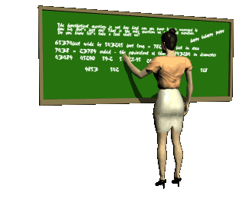
PSYCHOLOGY OF LEARNING AND HUMAN DEVELOPMENT
WELCOME
TO
EDUCATIONAL
PSYCHOLOGY

Slide 3
Core Subject – II PSYCHOLOGY LEARNER AND LEARNING cstpay; nehf;fpy; கற்பவர் கற்றலும்;

Slide 4
INTRODUCTION TO EDUCATIONAL PSYCHOLOGY
2. GROWTH AND DEVELOPMENT OF THE LEARNER
3. LEARNING
4. ATTENTION AND MEMORY
10. Guidance and Counselling
10.Units of Psychology
9. ADJUSTMENT AND MENTAL HEALTH
5. MOTIVATION AND GROUP DYNAMICS
8. INDIVIDUAL DIFFERENCES
7. PERSONALITY
6. INTELLIGENCE AND CREATIVITY

Slide 5
LEARNER AND LEARNING கற்பவர் கற்றலும்;
UNIT – I
INTRODUCTION TO EDUCATIONAL PSYCHOLOGY
கல்வி உளவியல் - அறிமுகம்;

Slide 6
UNIT – I INTRODUCTION TO EDUCATIONAL PSYCHOLOGY கல்வி உளவியல் அறிமுகம்;
Psychology: Meaning - Branches of Psychology - Methods of Study in Psychology -Schools of Psychology - Structuralism, Psychoanalysis, Behaviorism, Humanism, Transpersonalism, Gestalt Cognitive Psychology - Its implications – Educational Psychology: Meaning, Scope and Significance.

Slide 7
Psychology Origin and Beginnings
Speculations of the Greek philosophers and the development
Foundation for scientific psychology – Germans
1879 – beginning of modern psychological research
Wilhelm Wundt – considered the Father of Experimental Psychology; a structuralist
William James – developed functionalism (study of behavior as an integrated process

Slide 8
John B. Watson – set the direction of modern experimental psychology
ஜான் பி வாட்சன் - நவீன பரிசோதனை உளவியல்
Sigmund Freud – initiated the psychoanalytic movement of modern psychology
Psychoanalysis – has a considerable impact on personality theory and treatment of mental illness

Slide 9
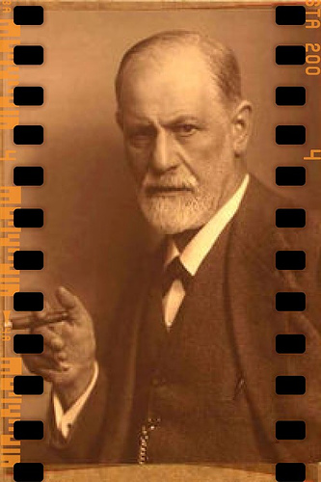
Psychology as scientific study அறிவியல் ஆய்வு போன்ற உளவியல்
Two Greek Term :
Psyche - soul, mind Logos - study
At first, “soul” has a religious implication
The science of human Behaviour
Best defined as the science of Behaviour and cognitive processes.
Father of Psychology is Sigmund Freud

Slide 10
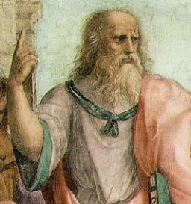

Historical Development of Psychology
cstpay; xU Md;kh
gpshl;nlh -mup!;lhl;½y;
kjk;- ,e;J rkz g[j;jk;

Slide 11
cstpay; kdj;jpd; mwptpay;
kdk; xU g[jpu;
ek; mf cWg;g[fspd; bkhj;;j Tl;likg;g[
cstpay; elj;ijapd; mwptpay;
thl;rd; nlhy;kd; !;fpd;du; - fz;zhy; fhz ,ayhj kdk; gw;wp Muha;tij tpl fhzf;Tlpa elj;ijna nky.;
S-R Stimulus and Responds

Slide 12
Definition of Psychology
The systematic study of Mind
The Science of Human Behaviour
Best defined as the science of Behaviour and cognitive processes

Slide 13
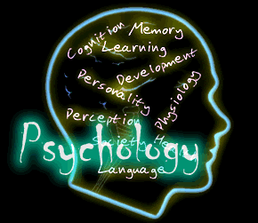
BRANCHES OF PSYCHOLOGY
General Psychology – explains the underlying principles of human behavior
study of how and why people behave this way or that way
Structural and functional mechanisms of the human body

Slide 14

Comparative Psychology
The behavior and mental processes of the different species also known as animal psychology
Activities of both man and animal are compared and differentiated, particularly in relation to genetic and evolutionary theories

Slide 15

Developmental Psychology
The study of human behavior in all its aspects of growth and Development
Involves the development of an individual in terms of stages

Slide 16
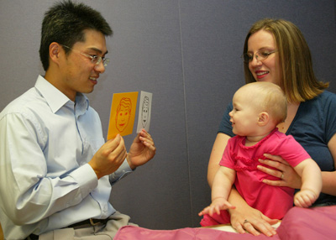
Child Psychology
The scientific study of human behavior from its post-natal beginnings up to early adolescence
Deals with the stages of growth and maturation
Effects of environmental influences upon individual patterns of development

Slide 17
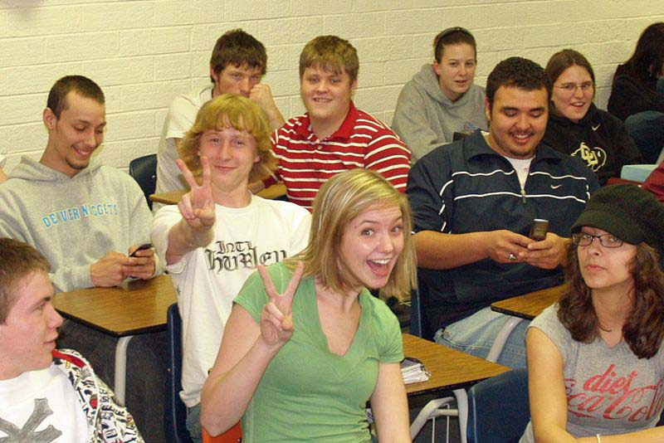
Adolescent Psychology
The study of human behavior from puberty to later life, approx. 12-20 y/o
Involves the physical and mental maturation of an individual, as well as the attainment of emotional and social maturity

Slide 18
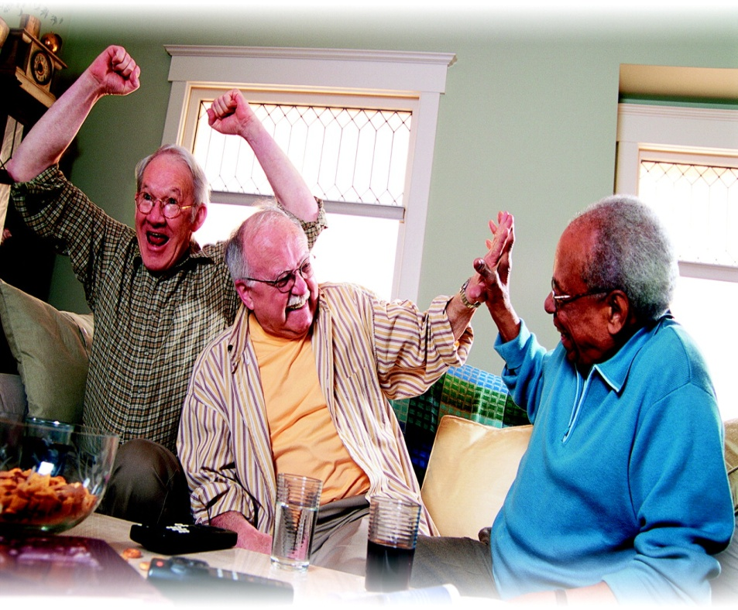
Senescent Psychology
Scientific study of human behavior in old age

Slide 19
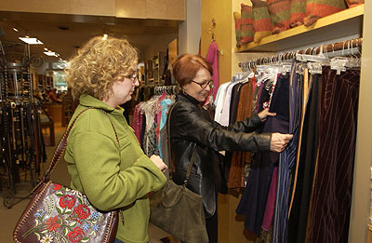
Consumer Psychology
concerned with the investigation of the varied facets of marketing and buying behavior
Other problems arising from the relationship between buyer and seller

Slide 20
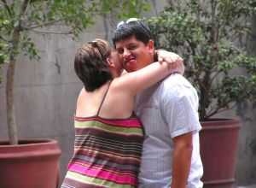
Abnormal Psychology
The scientific study of human and the etiology or cause of personal defects, or human’s behavior which deviates from the average reaction, hence abnormal

Slide 21

Business Psychology
Study of the principles of psychology as applied to business
Deals particularly with the behavior of consumers
Methods are employed to gain more customers and impress prospective buyers

Slide 22
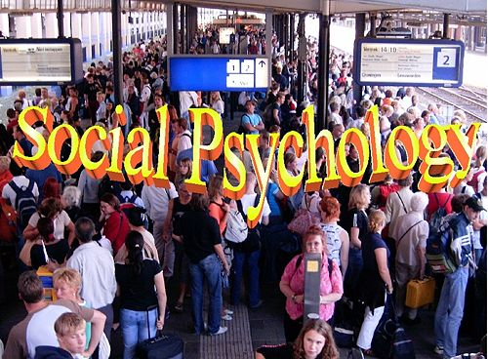
Social Psychology
study of the behavior of groups of individuals in their relationship to other groups

Slide 23

Cognitive Psychology
concerned with the mental processes involved in acquiring and using knowledge

Slide 24

Legal Psychology
Application of the principles of human behavior to law, or any legal proceedings

Slide 25
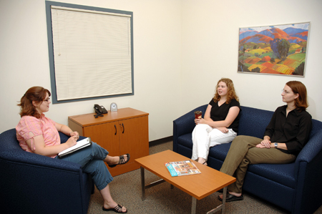
Clinical Psychology
largest area of specialization
Treatment and diagnosis of emotional and behavioral disorders

Slide 26
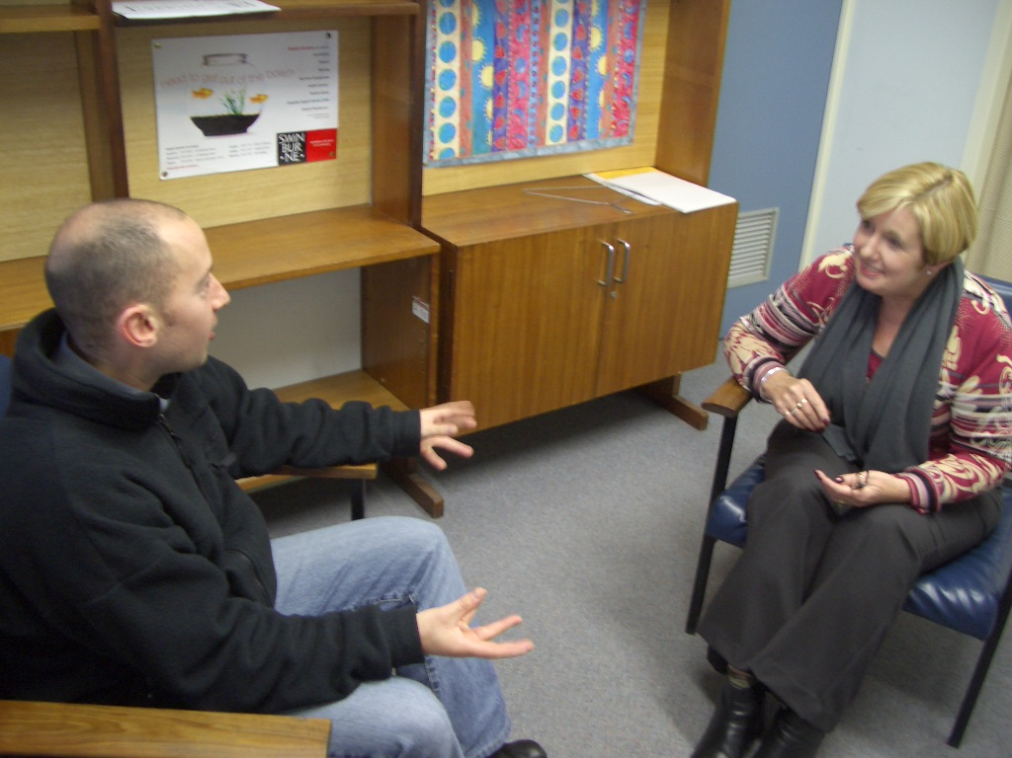
Counseling Psychology
Dedicated to helping people with educational, job or career, and social adjustments

Slide 27
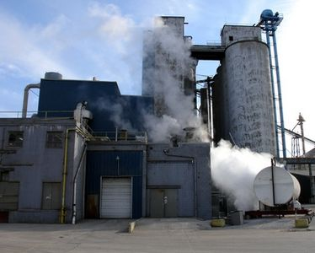
Industrial Psychology
study of human nature and reactions as related to problems of industry, especially affecting personnel and job efficiency

Slide 28

Experimental Psychology
Study basic psychological processes as sensation, perception, learning, memory, cognition, motivation, and emotion

Slide 29

Educational Psychology
A field of specialization that deals with learning, motivation, and other subjects in the actual educational process together with the practical application of psychological principles to education

Slide 30
METHODS OF STUDY IN PSYCHOLOGY- உளவியல் முறைகள்
Introspection
Self – reporting
Observation
Survey
Case study
Interview
Experimental
mfNehf;F Kiw
Ra - mwpf;if
cw;WNehf;fy;
Gs;sp tptuk;
;jdpahs; Ma;T
Neu;fhzy;;
gupNrhjid

Slide 31
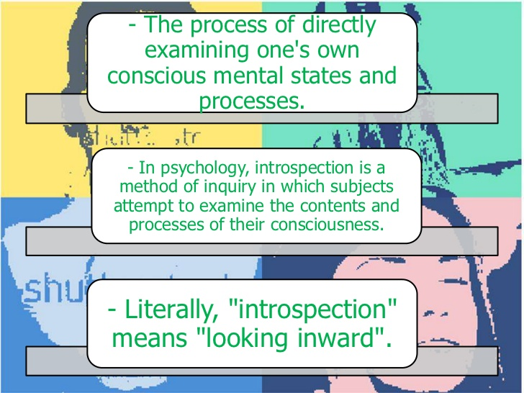
Introspection Method mfNehf;F Kiw

Slide 32
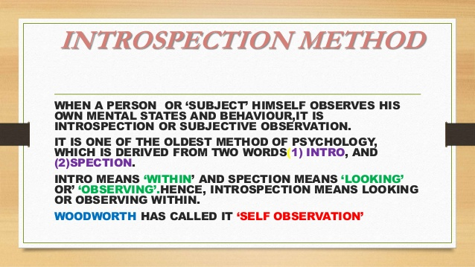

Slide 33
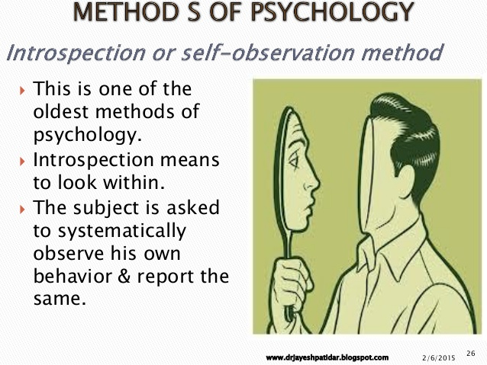

Slide 34

Self – Reporting- Ra - mwpf;if
A self-report study is a type of survey, questionnaire, or poll in which respondents read the question and select a response by themselves without researcher interference.
A self-report is any method which involves asking a participant about their feelings, attitudes, beliefs and so on. Examples of self-reports are questionnaires and interviews; self-reports are often used as a way of gaining participants' responses in observational studies and experiments.

Slide 35
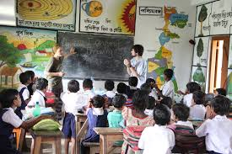
Observation- cw;WNehf;fy;
Observation is the active acquisition of information from a primary source. In living beings, observation employs the senses. In science, observation can also involve the recording of data via the use of instruments.

Slide 36

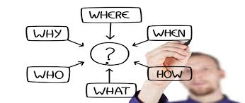
Case Study- jdpahs; Ma;T
A case study involves an up-close, in-depth, and detailed examination of a subject (the case), as well as its related contextual conditions. Case studies appear with great frequency throughout popular works, with nearly anybody able to claim to have done one.

Slide 37
Interview - Neu;fhzy;;
The assessment interview is at once the most basic and the most serviceable technique used by clinical psychologist
General characteristic of interviews :
An Interaction
Interviews versus tests : interviews are more purposeful and organized than conversation but sometimes less formalized or standardized then psychological test
The art of interviewing

Slide 38
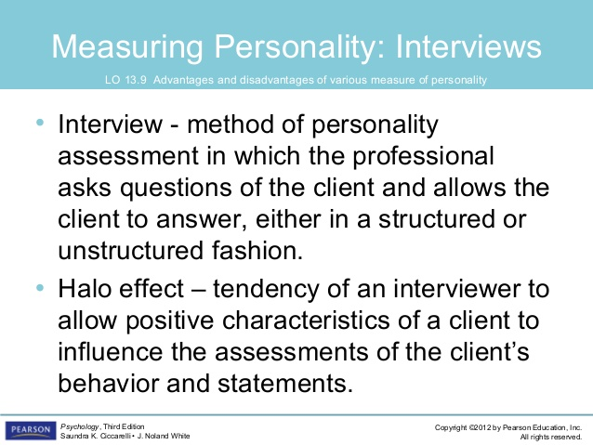
Interview - Neu;fhzy;;

Slide 39
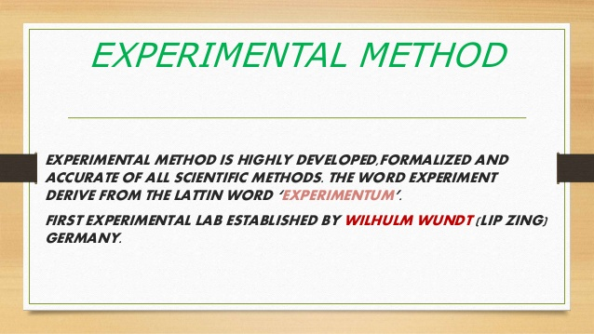
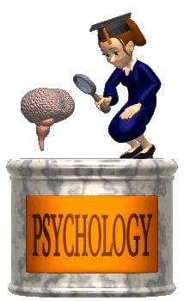
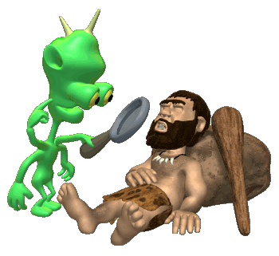

Slide 40
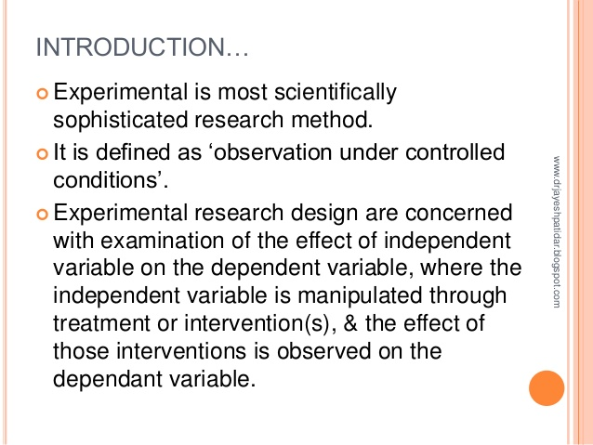

Slide 41
Hypothesis
Expresses a relationship between two variables.
A variable is anything that can vary among participants in a study.
Participating in class leads to better grades than not participating.

Slide 42

Independent Variable
Whatever is being manipulated in the experiment.
Hopefully the independent variable brings about change.
If there is a drug in an experiment, the drug is almost always the independent variable.

Slide 43

Dependent Variable
Whatever is being measured in the experiment.
It is dependent on the independent variable.
The dependent variable would be the effect of the drug.

Slide 44
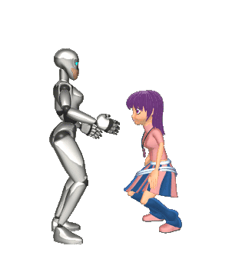

Operational Definitions
Explain what you mean in your hypothesis.
How will the variables be measured in “real life” terms.
How you operationalize the variables will tell us if the study is valid and reliable.
Let’s say your hypothesis is that chocolate causes violent behavior.
What do you mean by chocolate?
What do you mean by violent behavior?

Slide 45
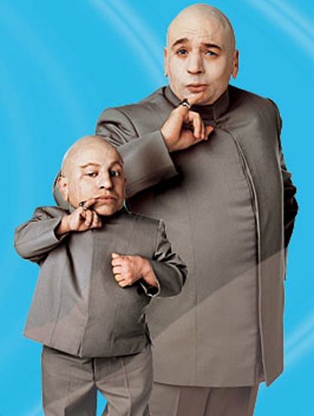
Sampling
Identify the population you want to study.
The sample must be representative of the population you want to study.
GET A RANDOM SAMPLE.
Stratified Sampling

Slide 46
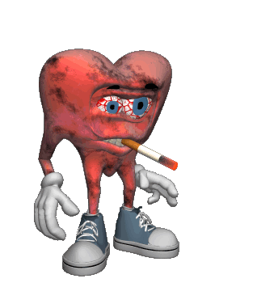
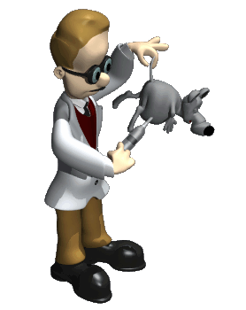
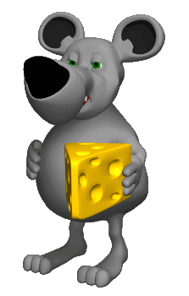
Experimental Method
Looking to prove causal relationships.
Cause = Effect
Laboratory v. Field Experiments
Smoking causes health issues.

Slide 47

Statistics
Recording the results from our studies.
Must use a common language so we all know what we are talking about.

Slide 48
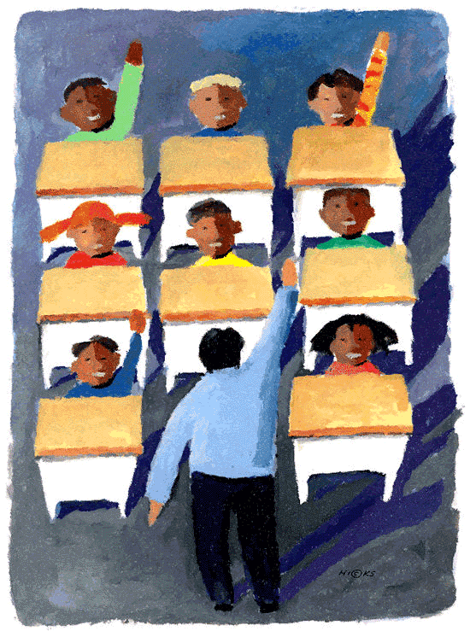
Schools of Psychology

Slide 49
Major schools of psychology உளவியல் கோட்பாடுகள்
BehaviorismPsychoanalysis
Humanism
Structuralism
Transpersonalism
Gestalt
Cognitive
elj;ijapay;
Csg;gFg;gha;t[
kdpjnehf;fpay;
mikg;g[epiy
jd;Dzu;t[ fle;j
KGikf;fhl;rp
mwpt[[rhu;

Slide 50
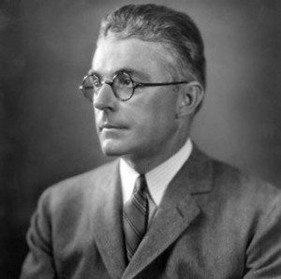
Behaviorism elj;ijapay;
John Broadus Watson (January 9, 1878 – September 25, 1958) was an American psychologistwho established the psychological school of behaviorism. Watson promoted a change in psychology through his address Psychology as the Behaviorist
சீரமைப்பு மனித நடத்தை அடிப்படையில் உள்ளது என்று வாதிட்டார்.
J.B Watson

Slide 51
Behaviorism—John Watson
Definition: School of psychology that studies only observable and measurable behavior.
John Watson:
You cannot define conscious any more than you can define a soul.
You cannot locate or measure consciousness, and therefore it cannot be the object of scientific study.
Studies observable, measurable behavior and nothing more.
Ivan Pavlov’s Classical Conditioning
Watson’s Experiment with Little Albert and the white rats (happy 11 month old conditioned to be afraid of white rats)
Mary Cover Jones (1924) eliminating fears through conditioning (Peter Experiment)

Slide 52
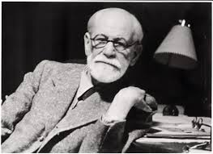
Psychoanalysis csg;gFg;gha;t[
Sigmund Freud

Slide 53
Psychoanalysis csg;gFg;gha;t[
FOUNDER SIGMUND FREUD :
MAY 6, 1856 – SIGMUND FREUD WAS BORN IN FREYBERG TOWN. CRECH REPUBLIC 1881 – HE GRADUATED FROM MEDICAL FACULTY, UNIVERSITY OF VIENNA1896 – SIGMUND FREUD WAS OFFICIALLY RECOGNIZED .1900 – HE RELEASED ‘INTERPRETATION OF DREAMS’ SEPTEMBER 23, 1939 –FREUD PASSED AWAY IN HAMPSTEAD HOUSE.
OVERVIEW OF PSYCHOANALYSIS
A set of philosophical of human nature
Psychoanalysis is both an approach to therapy and a theory of personality
Emphasizes unconscious motivation – the main cause of behavior lie in unconscious mind

Slide 54


Psychoanalysis—Sigmund Freud
Medical Doctor/Neurologist
Studied hypnosis and found the “unconscious”
Published The Interpretation of Dreams
Believed that much of our behavior is governed by hidden motives and unconscious desires.
Maintained that many unconscious desires and conflicts are sexual.
Believed that childhood experiences determined adult personality.

Slide 55
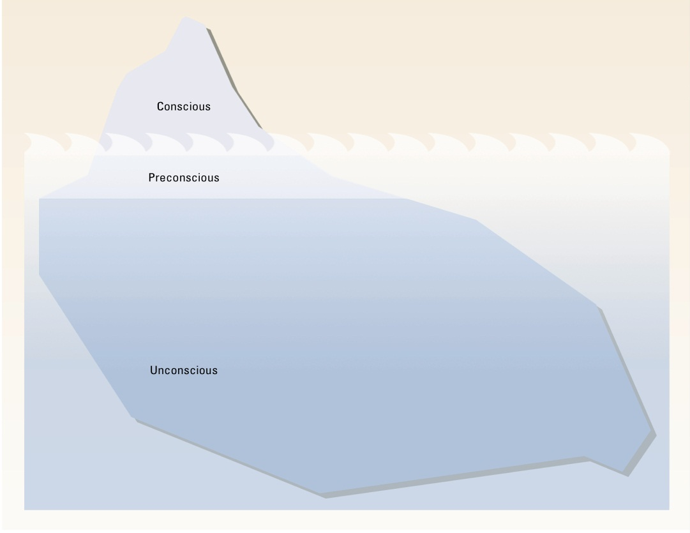
Psychoanalysis csg;gFg;gha;t[
ID
EGO
SUPER EGO

Slide 56

Humanism kdpjnehf;fpay;
Carl Ransom Rogers (January 8, 1902 – February 4, 1987) was an influential American Psychologist and among the founders of the humanistic approach (or client-centered approach) to psychology. Rogers is widely considered to be one of the founding fathers of psychotherapy research and was honored for his pioneering research with the Award for Distinguished Scientific Contributions by the American Psychological Association (APA) in 1956.
சுய விழிப்புணர்வு மற்றும் சிந்தனை நடவடிக்கைகள் மூலம் ஒரு ஆரோக்கியமான எதிர்வினைகள் இணைவதில் அனுமதிக்கிறது.
Carl Rogers (1902–1987), one of the founders of humanistic psychology.

Slide 57
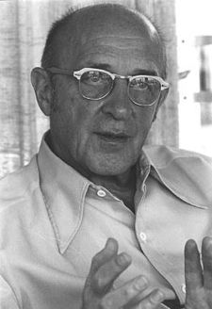
Humanistic Psychology
Definition: School of psychology that emphasizes nonverbal experience and altered states of consciousness as a means of realizing one’s full human potential.
Goal: To ensure mental healthiness of individuals and develop therapeutic techniques.
Psychologists: Abraham Maslow and Carl Rogers

Slide 58
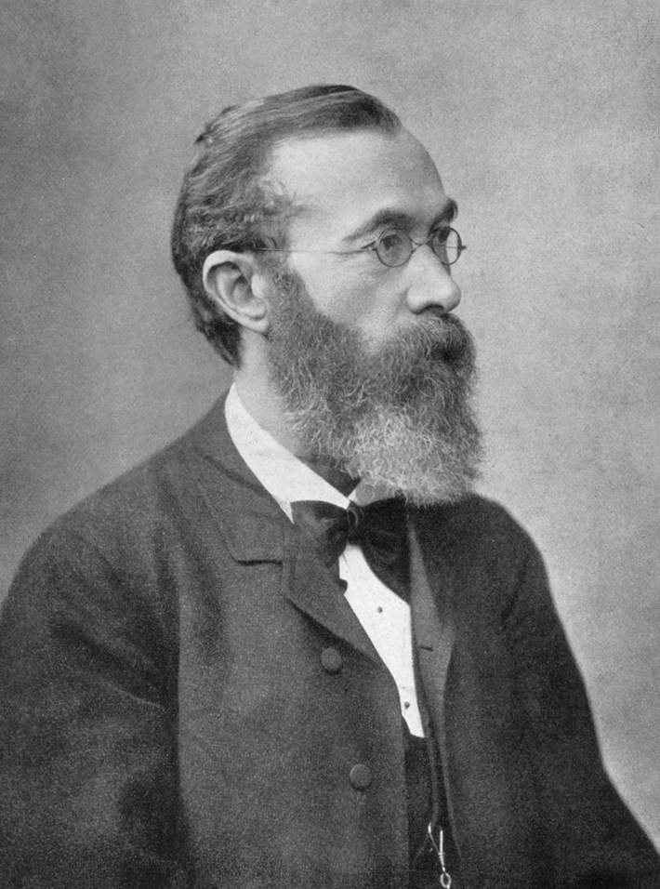
Structuralism mikg;g[epiy
Wilhelm Maximilian Wundt (16 August 1832 – 31 August 1920) was a German physician, physiologist, philosopher, and professor, known today as one of the founding figures of modern psychology. He is widely regarded as the "father of Experimental psychology". In 1879, Wundt founded the first formal laboratory for psychological research at the University of Leipzig.
Wilhelm Wundt in 1902

Slide 59
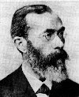
Structuralism—Wilhelm Wundt
Definition: School of Psychology that stresses the basic units of experience and combinations in which they occur.
Wilhelm Wundt:
Physiologist and Philosopher
Founded the first experimental psychology laboratory in 1879—Leipzig Lab.
Argued that the mind must be studied objectively and scientifically.
Main concern was with techniques used for uncovering natural laws of the human mind—HE WAS IN SEARCH FOR THE BASIC UNIT OF THOUGHT.

Slide 60
Transpersonalism jd;Dzu;t[ fle;j[
Transpersonal psychology is a sub-field or "school" of psychology that integrates the spiritual and transcendent aspects of the human experience with the framework of modern psychology. It is also possible to define it as a "spiritual psychology". Thetranspersonal is defined as "experiences in which the sense of identity or self extends beyond (trans) the individual or personal to encompass wider aspects of humankind, life, psyche or cosmos". It has also been defined as "development beyond conventional, personal or individual levels

Slide 61
Gestalt Psychology KGikf;fhl;rp
Definition: School of Psychology that studies how people perceive and experience objects as whole patterns
Short lived—people didn’t really see its potential.
Approaches structuralism from a different angle. Example: When we see a tree, we see just that, a tree, not a series of branches.

Slide 62

Cognitive Psychology
Definition: School of psychology devoted to the study of mental processes generally.
Goal: To explore the mental processes involved in judgment, decision making, and other aspects of complex thought.

Slide 63
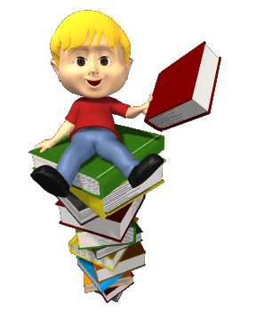
Thank You

Slide 64
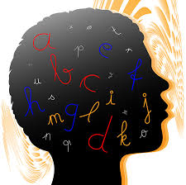

;
UNIT – II
GROWTH AND DEVELOPMENT OF THE LEARNER fw;gtu;; tsu;r;rp kw;Wk; Kd;ndw;wk;

Slide 65
UNIT – II: GROWTH AND DEVELOPMENT OF THE LEARNER
Growth and Development: Meaning, factors influencing Growth and Development -Stages of development and its characteristics - Adolescence: problems and solutions Dimensions of development: Physical, Cognitive, Social, Emotional and Moral - and Theories of development - Piaget’s Cognitive Development - Freud’s Psycho-sexual Development - Erikson’s Psycho - Social Development.

Slide 66
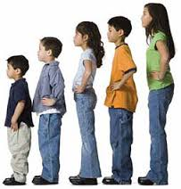
GROWTH AND DEVELOPMENT
tsu;r;rp kw;Wk; Kd;ndw;wk;
;;

Slide 67
GROWTH tsu;r;rp
Increase with height,weight,size,obesity
Not continues process - Maturation
Growth is changed in child + CH – AD +
Compare with others
Measuring
Foundation - Food

Slide 68
tsu;r;rp bfhs;iffs;/ epajpfs;
tsu;r;rpapd; nghf;F
bjhlu;r;rpj; jd;ik
tupirj; jd;ik
Kjpu;r;rp
jdpahs; ntw;Wik
Direction
Continuity
Sequence
Maturation
Individual difference

Slide 69
DEVELOPMENT Kd;ndw;wk;;
XUtupd; tsu;r;rpnahL Tlpa kd tsu;r;;rpa[k;, elj;ij tsu;r;rpiaa[k; Fwpf;Fk.; ,J Kjpu;r;rpahy; jPu;khzpf;fg;gLfpwJ.
fPH; epiyapypUe;J nky; epiyf;F bry;tJ
Xg;gpl;L ghu;j;jy; Kyk; mwpayhk;
bjhlu;r;rpahdJ
mDgtk; Kjpu;r;rp tpisthf epfGk;
tsu;r;rpapy;yhkYk; Kd;ndw;wk; fhzg;gLk;
juj;ij fzpf;f Klpa[k;

Slide 70
Principles of Growth and Development tsu;r;rp kw;Wk; Kd;ndw;wk; bfhs;iffs;
tsu;r;rp
Jy;ypakhf mstplyhk;
bjhlu;r;rpahdJ ,y;iy
K. cl;TWjhd;
Gy cWg;g[fspy; Vw;gLk;
jdpahs;ntw;Wik
Kd;ndw;wk;
elj;ijfshy;
bjhlUk; bray;
gd;Kfk; bfhz;lJ
Xl;Lbkhj;j khWghL
khWgLk;-m x r.czu;t[

Slide 71
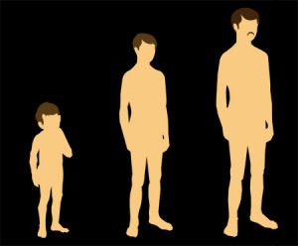
Maturation Kjpu;r;rp
xU braiyr; bra;tjw;Fwpa gf;Ftkhd cly; tsu;r;rp
fw;wy; Vw;gLk;

Slide 72
tsu;r;rp Kd;ndw;wk; Kjpu;r;rp fw;wy; bjhlu;g[fs;
Growth – Maturation –Development
Growth – Environment – Readiness – Learning - Development

Slide 73
STAGES OF DEVELOPMENT
Prenatal - Pregnancy
Infancy – Birth -2 week
Babyhood - 3 w -2 year
Early Childhood 3-6 Y
Later childhood 7-12 Y
Adolescence 12- 18 Y
Early Adulthood 19 -40 Y
Middle Age 40 -60 Y
Old age 60 - Death
fUtiwg; gUtk;
rpRg; gUtk;physic
jtH; eilg; gUtk;
,s FHe;ijg; gUtk;
gps;isg; gUtk;
Fkug;gUtk;
taJte;njhu; gUtk;
eLtaJg; gUtk;
Kjpu; gUtk;
D:\Psychology\Baby process.wmv
D:\Psychology\Funny Baby Makes A Speech.wmv

Slide 74
Dimensions of Development
Physical – cly; tsu;r;rp
Cognitive - mwpt[ tsu;r;rp
Emotional - kdbtGr;rp
Social - rKf tsu;r;rp
Moral - xGf;f tsu;r;rp

Slide 75
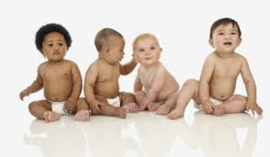
Infancy – Birth -2 week(15 days) rpRg; gUtk;
Birth Cry
Mass activity
Specific activity
Crying

Slide 76
Babyhood - 3 w -2 year jtH; eilg; gUtk;
Independence Movement- gpwiu rhuj jd;ik
Foundation Age-mlpjs taJ
Physical – H W Well growth, Control for Urine and others, Power – Hand, crying Babbling Gesturing
Mental – Concept, self concept
Emotional – Continuous emotional
Social – Sensory motor , Exploratory, Imitation, Games, Amusing

Slide 77
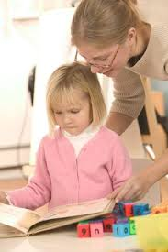
Early Childhood 3-6 Y ,s FHe;ijg; gUtk;

Slide 78
Early Childhood 3-6 Y ,s FHe;ijg; gUtk;
elkhLk; nfs;tpf;Fwp-vjpu;kiw elj;ij jhf;Fjy; czu;t[ jd;dyk; ghypd btWg;gzu;t[
Physical – slow, Organs dev. Speech
Mental – Sex roles
Emotional – not a control, interest like with play, dress, food etc..
Social – unsocial ( negativism, Aggressiveness, selfishness, Sex antagonism-p-vjpu;kiw elj;ij- jhf;Fjy; czu;t[- jd;dyk; ghypd btWg;gzu;t[.

Slide 79
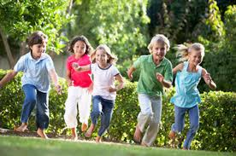
Later childhood 7-12 Y gps;isg; gUtk;

Slide 80
Later childhood 7-12 Y gps;isg; gUtk;
Play Age / Gang Age
Physical – Speech improve
Emotional – Control of Sexual ,
Social – Gang
Personality –
Self concept

Slide 81
Adolescence 12- 18 Y Fkug;gUtk;
Adolescence – To grow to Maturity
Hurlock - Sexual Maturity -------Adulthood
Puberty – Female 12-14 / Male -14-15
Adolescence Types :
Early 12 -15 (Teen Age)
Late – 16-18 (Young Man)
D:\Psychology\Problems of Adolescence.wmv

Slide 82
ADOLESCENCE
PHYSICAL APPEARNCE
PRIMARY SEX CHARACTERISTICS
SECONDARY SEX CHARACTERISTICS
PROBLEMS
BODY IMAGE / CLUMSINESS AND AWKWARDNESS
MATURING – EARLY LATE
INAPPROPRIATE SEX-PHYSIQUE
MALE AND FEMALE SOCIAL ADJUSTMENT BEHA.

Slide 83
Fkug;gUtg; gpur;ridfs;
cly; rhu;e;j gpur;ridfs;
gs;sp gpur;ridfs;
gpwu;bjhlu;ghd gpur;ridfs;
jdJ brhe;jg; gpur;ridfs;
bjhHpy; rhu;e;jg; gpur;ridfs;

Slide 84
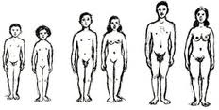
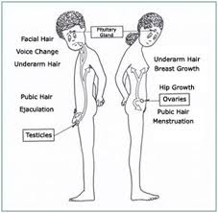
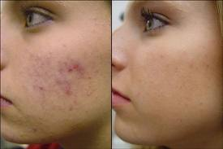

Slide 85
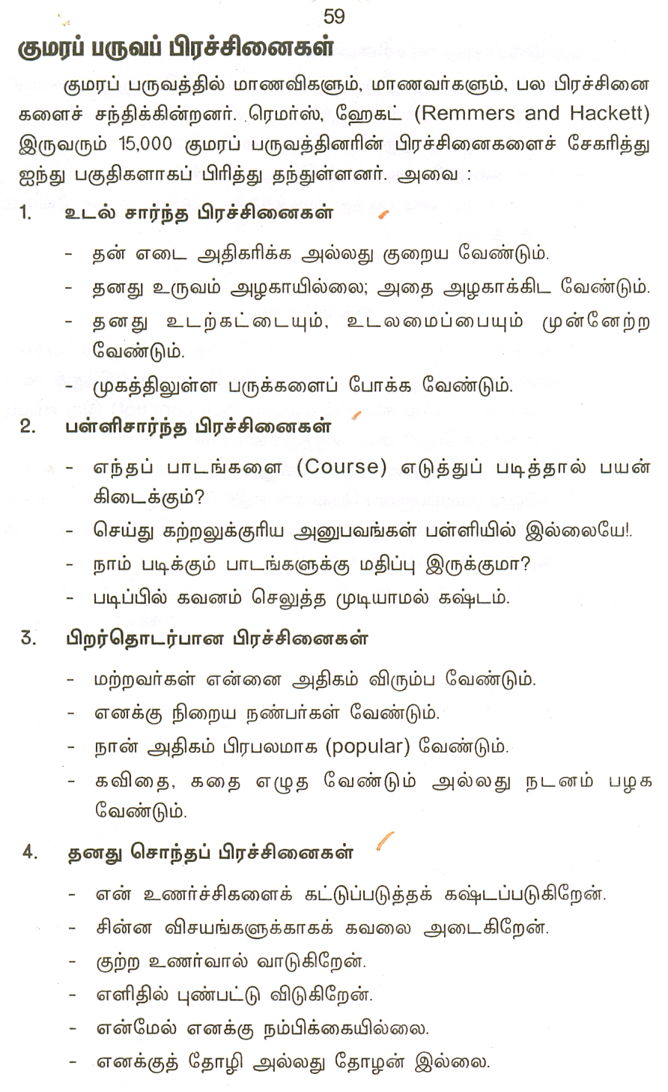

Slide 86


Slide 87
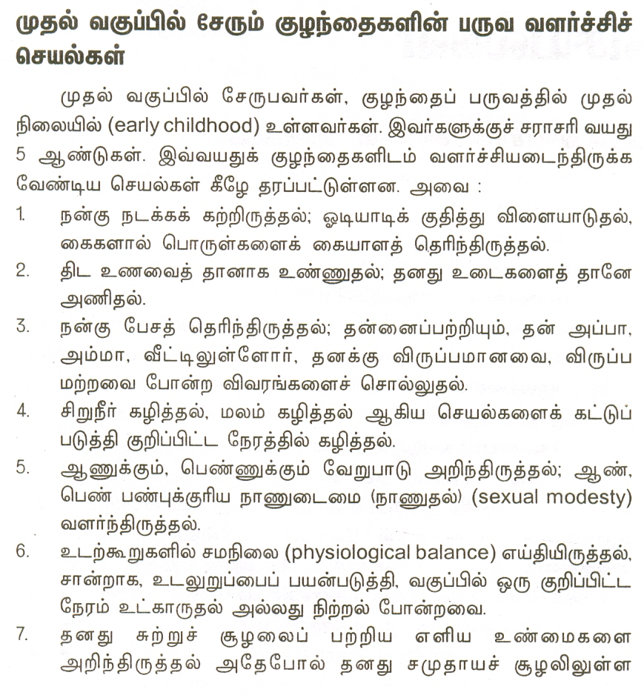

Slide 88
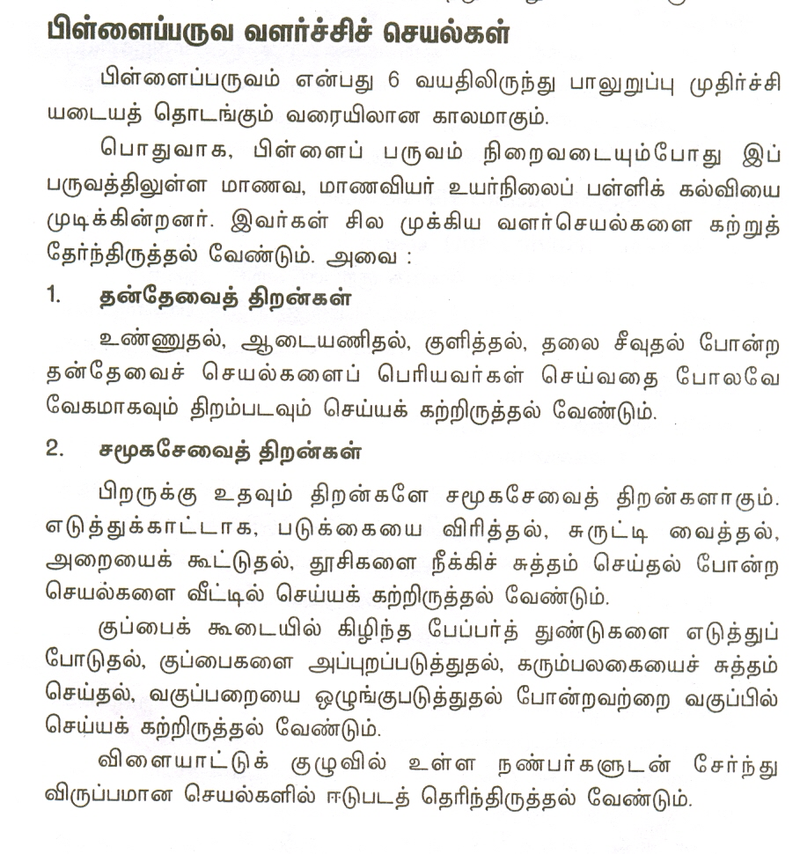

Slide 89
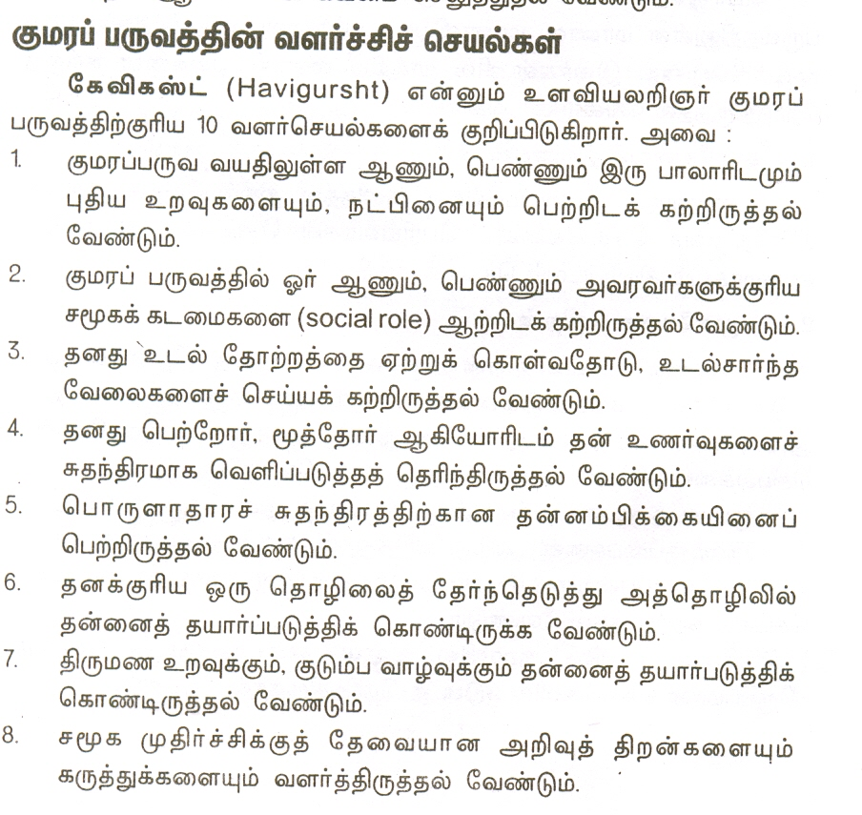

Slide 90
Theories of Development tsu;r;rp Nfhl;ghLfs;
Cognitive development:Process-Stage (Piaget)
gpahNI mwpjpwd; tsu;r;rp
Psychosexual Development-(Freud)
csk;rhu;e;j ghYzu;T tsu;r;rp
Psychosocial development (Erikson)
csk;rhu;e;j rKf tsu;r;rp

Slide 91
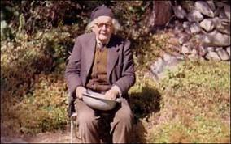




PIAGETS STAGES IN COGNITIVE DEVELOPMENT

Slide 92



Piaget’s Background
Born: August 9, 1896
Died: Sept. 16, 1980
Birth Place:
Neuchatel, Switzerland
Education:
Received PhD from University of Neuchatel
Married in 1923 to Valentine Chatenay and bore 3 children

Slide 93
PIAGETS STAGES IN COGNITIVE DEVELOPMENT gpahnItpd; mwpt[g;g[y tsu;r;rp epiyfs;
1 -15 mwpthdJ 4 epiyfspy ,Uf;Fk;
,t; tsu;r;rp epiy glpglpahf elf;Fk;
taJ Tl Ez;ikahd jd;ik
ifahSk; jd;ik

Slide 94
mwpt[g;g[y tsu;r;rp epiyfs STAGES IN COGNITIVE DEVELOPMENT;
Sensori motor stage
g[ydpaf;f epiy 0 -2
Preoperational Stage
braYf;F Ke;jpa epiy 2- 7
Concrete operations
gUg;bghUs; epiy 7 -11
Formal Operations
fUj;jpay; epiy 11 -15

Slide 95

D:\Psychology\Piaget's Cognitive Stages of Development.wmv

Slide 96
Sensori motor stage g[ydpaf;f epiy 0 -2
R{Hypy; jd;id jdpna gpupj;J fhDk;
,af;fk; xyp xsp <u;fg;gLk;
gplpj;j braiy ePlpj;J bra;a[k;
ifahSjy; milahsk; fhzy;
;

Slide 97
Preoperational Stage braYf;F Ke;jpa epiy 2- 7
bkhHp FwpapLfis gad;gLj;Jt[k;
VW ,w mLf;fp itf;f bjupa[k;
fzf;F gapw;r;rpfs; bra;a[k;
rpf;fy; jd;ikia Muha;a bjupahJ
v.fh uhjhit tpl ukh cau;e;jts; ckh tpl
fyhittpl mzpjh cau;e;jts;. Ckhittpl mzpjh cau;e;jtd; vdpy; fyhit tpl ckh cau;e;jtsh
555555 kuj;jpy; 555555 gHj;ij DD DDD ju;nwd;

Slide 98
Pre-operational thinking and problems of conservation
Conservation of liquid

Slide 99
Pre-operational thinking and problems of conservation

Slide 100
Pre-operational thinking and problems of conservation

Slide 101
Pre-operational thinking and problems of conservation

Slide 102
Pre-operational thinking and problems of conservation

Slide 103
Pre-operational thinking and problems of conservation

Slide 104
Pre-operational thinking and problems of conservation

Slide 105
Pre-operational thinking and problems of conservation
Reversibility: The pouring
of water into the small
container can be reversed.

Slide 106
Conservation of mass

Slide 107
Conservation of mass

Slide 108
Conservation of mass

Slide 109
Conservation of mass

Slide 110
Concrete operations gUg;bghUs; epiy 7 -11
rpe;jid tsu;r;rp tsUk;
Xw;Wik ntw;Wik jd;ik bjupa[k;
rpe;jpg;gjw;fhd gUg;bghUs; mtrpak;

Slide 111
Formal Operations fUj;jpay; epiy 11 -15
KG rpe;jid
cau; rpe;jid
fhuz fhupa fz;lwpjy;
braypd; jd;ikia mwptu;

Slide 112
Psychosexual Development-(Freud)
csk;rhu;e;j ghYzu;T tsu;r;rp

Slide 113

Sigmund Freud’s theory of psychosexual development
Sigmund Freud’s theory of psychosexual development
By: Christina, Amanda, Melissa, and Sam

Slide 114
csk;rhu;e;j ghYzu;T tsu;r;rp
Oral Stage(0-1)
Anus Stage (2-3)
Phallic Stage (4-5)
Latency Stage (6-12)
Genital Stage (12-18)
tha; epiy
Fj epiy
tpiwg;g[ epiy
cs;Siw epiy
ghYWg;g[ epiy

Slide 115

The Oral Stage

Slide 116
The oral stage
Starts from birth until 18 months
The focus of pleasure is the mouth. i.e.: Sucking and teething
When the child is being nursed it gives him the psychological pleasure of being cared for, mothered and held.
Later they are likely to retain a life long desire to bite things, such as: chewing on the ends of pencils or pens, gum and biting nails.

Slide 117

The Anal Stage

Slide 118
The anal stage
Begins at 18 months
The child’s natural focus of pleasure is the anus and bodily functions.
When the child begins to toilet training.
This stage lasts between one and two years of age.

Slide 119

The Phallic Stage

Slide 120
The Phallic Stage
This stage lasts from three and seven years of age.
The focus of pleasure is the genitalia, masturbation is also common during this period.

Slide 121

The Latency Stage

Slide 122
The Latency Stage
This stage lasts between five and seven years old until around puberty.
During this stage their earlier focus is repressed.
School, athletics, and same sex friendships is the main focus.

Slide 123

The Genital Stage

Slide 124
The genital Stage
This stage begins at puberty and continues through their adolescence.
Their energy is once again back to being focused on the genitals
mainly the focus of pleasure is in sexual intercourse.
D:\Psychology\Freud's Psychosexual Stages.flv

Slide 125


SOCIAL DEVELOPMENT

Slide 126
Social development
rKf tsu;r;rp
rKfj;jpy; gpwUld; ,zf;fkhf gHft[k; rKfj; jpwd;fisa[k; gz;g[fisa[k; fw;W mjw;nfw;g jdJ elj;ijia cUthf;fp bfhs;Sk; bray;.

Slide 127
Social development
gs;sp - gz;ghL rkj;Jtk; ePjp kjr;rhu;gpd;ik kdpjcupik neu;ik kjpg;gspj;jy; gpwu; eyd; mf;fiw
rKfk; bghUshjhu jd;ikapy; gHFk; tpjk; kdpj khz;g[fs; cwt[fs;
rKf czu;t[ ehk; vd;w czu;t[

Slide 128
Social development
FLk;g cwt[fs; - rnfhju cwt[
Ra tpku;rdk; - rhu;bgz;zk;
Xg;ghu; FG kw;Wk; tpisahl;L
jd;idawpjy;

Slide 129


Erikson was of mixed Danish and Jewish parentage. After his parents' divorce, he had no contact with his father.
After completing his education, he wandered around Europe, unsure of what career to follow.
He tried painting and wood carving and accepted an offer to teach art at a private school in Vienna for children whose parents were undergoing analysis at Freud's Psychoanalitic Insititute.
Known as the Father of Psychosocial Development
When he came to America, he needed to redefine his identity as an immigrant.
Born in Frankfurt, Germany in June 15, 1902
He concluded that the quest for identity is the major theme in life.

Slide 130
Erik Erikson’s Eight Stages of Human Development
8 - Integrity vs. despair
ey;ypzf;fk; -Vkhw;wk
7 - Generativity vs. stagnation
gilg;g{f;fk;- njf;fepiy
6 - Intimacy vs. isolation beUf;fk; jdpik
5 - Identity vs. identity confusion
jd;dpiyawpjy; -jd;dpiyFHg;gk;
4 - Industry vs. inferiority flpdciHg;g[ -jhH;czu;t[
3 - Initiative vs. guilt jhd;fw;wy; -Fw;wczu;t[
2 - Autonomy vs. shame and doubt jd;dhl;rp -btl;fk; re;njfk;
1 - Trust vs. mistrust ek;gpf;if -mtek;gpf;if

Slide 131
Erikson’s Human Development Stages
1 - Trust vs. Mistrust
ek;gpf;if –mtek;gpf;if
0–1 years
2 - Autonomy vs. Shame and Doubt
jd;dhl;rp -btl;fk; re;njfk
1–3 years
3 - Initiative vs. Guilt
jhd;fw;wy; -Fw;wczu;t[ 3–5 years
Developed through consistent love and support -Mother
Independence fostered by support and encouragement- Parents
Developed by exploring and accepting challenges -Family

Slide 132
Erikson’s Human Development Stages
4 - Industry vs. Inferiority
flpdciHg;g[ -jhH;czu;t[;
6 years–puberty
5 - Identity vs. Role Confusion
jd;dpiyawpjy; -jd;dpiyFHg;gk Adolescence
6 - Intimacy vs. Isolation
beUf;fk; - jdpik
Early adult years
Mastery comes from success and recognition-Environment, school
Exploration of different paths to attain a healthy identity – Peer Groups
Form positive, close relationships with others-
Relationship

Slide 133
Erikson’s Human Development Stages
7 - Generativity vs. Stagnation
gilg;g{f;fk;- njf;fepiy
Middle Adulthood
8 - Integrity vs. Despair
ey;ypzf;fk; -Vkhw;wk; Late Adulthood
Transmitting something positive to the next generation –sharing
Life review and retrospective evaluation of one’s past – We feeling

Slide 134
THANK YOU

Slide 135


UNIT -3
LEARNING
கற்றல்

Slide 136
fw;wy;
xUtu; elj;ijapy; epfGk; epiyahd khw;wnk fw;wy;
,ay;g[fs; -
mDgtk; gapw;r;rp ,tw;wpd; tpisnt fw;wy;
elj;ijkhw;wk; cz;lhf;FtJ
glpglpahd bjhlu;r;rpahd xU bray;
,ay;ghd elj;ijia khw;wf;TlpaJ

Slide 137
fw;wy; -Kf;fpaj;Jtk;
mwpt[ tsu;r;rp Vw;gLk;
g[J elj;ij nfhyk; cUthFk;
gpur;ridf;F jPu;t[fhDk; jpwd;
mwpt[ bgw bgw;w mwpit tsu;j;jpl
j[pwd;fis tsu;f;f

Slide 138

fw;wypy; - jdpahs; ntw;Wik
kdpju;fSf;fpilna clyikg;g[ elj;ij nghd;wtw;wpy; fhzg;gLk; epiyj;j ntWghLfSf;F jdpahs; ntw;Wik.
ilyu;
mwpthz;ik -milt[j;jpwd; -rpwg;g[j;jpwd; -MSik -Mu;tk; -mwpt[g[yk;
taJ -ghypdk; -,dk;- rKf epiy -R{Hy; kug[
tiffs;
xUtUf;F mtUf;Fs;nsna ntWghL
,UtUf;F ,ilna ntWghL
FGtpdu; kj;jpapy; ntWghL
fw;wypy; ntWghL
clw;gz;gpy; -mwpt[j;jpwdpy; -ehl;lj;jpy; -milt[j; nju;tpy; -clypaf;fk; kdg;ghd;ikapy; -MSik gz;g[fspy; -Mu;tj;jpy;

Slide 139






Theories of Learning
fw;wy; nfhl;ghLfs;

Slide 140

Trial and Error Learning Kad;W jtwpf; fw;wy;

Slide 141

Edward Lee Thorndike
Born August 31, 1874
Died August 9, 1949
Born in Williamsburg, Massachusetts
Studied animal behaviour and the learning process
led to the theory of connectionism
Laying the foundation for modern educational psychology.

Slide 142



Cats in Puzzle Boxes

Slide 143

Classical Conditioning giHa Mf;f epiyapWj;jk;

Slide 144

Ivan Pavlov (1849-1936)
September 14, 1849
Born in Ryazan, Russia
Father was a town Priest
Pavlov, a Russian physiologist, first described classical conditioning in 1899 while conducting research into the digestive system of dogs.
Began graduate work at the Military Medical academy. 1875
Received doctorate. Finished dynamic nerves of the heart. 1883
Professor of Physiology at the University of St. Petersburg Institute of Experimental Medicine. 1890
Nobel Prize for Medicine or Physiology in 1904.
February 27 – Ivan Pavlov died of liver cancer in Leningrad at the age of 87.

Slide 145

Pavlov’s Research
braw;ifahd g[wj;J}z;lY}f;F ,aw;f;ifahd Jyfy;
eha; - Tz;L -ckpH; ePu;msf;Fk; fUtp ,izg;g[ - kzpbahsp
1. kzpbahsp – c Ruf;ftpy;iy
2 czt[ - ckpH; ePu; Rue;jJ
3. kzpbahsp -czt[ -ckpH; ePu;
Rue;jJ
4. kzpbahsp ckpH; ePu; Rue;jJ
D:\Psychology\Classical Conditioning - Ivan Pavlov.wmv

Slide 146


Slide 147

D:\Psychology\Psych 120 Classical Conditioning.wmv
D:\Psychology\Classical Conditioning - Ivan Pavlov.wmv

Slide 148
Trial and Error Learning Kad;W jtwpf; fw;wy;
D:\Psychology\Thorndike-puzzle box.wmv
nrhjid
g{id -Fz;zhlp Tz;L bgl;lp - Edf;fkhd jhH;ghs; - czt[ kPd;
fw;wy; tpjpfs;
Maj;j tpjp Law of Effect– g{id grpnahL ,Uj;jy;
gapw;r;rp tpjp Law of Exercise – jpUk;g jpUk;g Kad;wy;
tpist[ tpjp Law of Readiness – kPd; czt[
gad;fs;
Maj;j epiyf;nfw;g fw;gpj;jy;
fw;gpj;jypy; gupR jz;lid
mjpfkhd gapw;r;rpfs;
Cf;Ftpj;jYk; Mu;tj;ij J}z;lY}k; jhu;z;ilf;fpd; -

Slide 149

Skinners Operant Conditioning bray;gL Mf;f epiyapWj;jk

Slide 150

Burrhus Frederic Skinner
Born March 20, 1904
Died August 18, 1990
Born in Susquehanna, Pennsylvania
American psychologist, author, inventor, advocate for social reform and poet.
Innovated his own philosophy of science called Radical Behaviorism

Slide 151



Operant Conditioning Chamber (“Skinner Box”)

Slide 152
Operant Conditioning bray;gL Mf;f epiyapWj;jk;
fw;gtnu jd; tpUg;gj;Jld; btspg;gLj;Jk; bray;
nrhjid
Xyp g[fhj ,Uz;l bgl;lp – bfhf;fp- czt[ - Vyp
gad;fs;
fw;wypy; Fwpf;nfhs;
gpd;D}l;lk;
gupR tY{l;lk;
Mrpupau; khztu; re;jpg;g[
Fw;wy; ts ikak;
D:\Psychology\Skinner's Operant Conditioning.wmv
D:\Psychology\Skinner Box - Lever Press.wmv

Slide 153
Skinner on Education
Skinner says that there are five main obstacles to learning:
People have a fear of failure.
The task is not broken down into small enough steps.
There is a lack of directions.
There is also a lack of clarity in the directions.
Positive reinforcement is lacking.
Use five principles to remedy the above problems:
Give the learner immediate feedback.
Break down the task into small steps.
Repeat the directions as many times as possible.
Work from the most simple to the most complex tasks.
Give positive reinforcement.

Slide 154


Learning by Insight (Kohler)

Slide 155
Introduction to Kohler
Kohler was born in Estonia, and earned his Ph.D from the University of Berlin in 1909 on psycho-acoustics.
From 1910 to 1913 he collaborated with Wertheimer and Koffka, working on the foundations of what would become known as "Gestalt" theory.
From 1913 to 1920, he was director of a research station in Canary Islands where he conducted behavioral research with animals.. Later he served as director of the Psychology Institute, Berlin.
In 1925-26 Kohler was a visiting professor at Clark University in the United States. In 1934-35 he was William James Lecturer at Harvard and in 1935 a visiting professor at the University of Chicago.
He came to the United States in 1934, where he became professor of psychology at Swarthmore College. Kohler is best known for the influence of his writings in the founding of the school of Gestalt psychology.

Slide 156
Chimp Experiments
Kohler's chimps were able to do more than use tools, he actually observed chimps building tools. For example, he observed chimps breaking off branches from a tree to make a "rake."
One of the smartest chimps, Sultan, was given a very difficult problem. Kohler placed a bunch of bananas outside Sultan's cage and two bamboo sticks inside the cage. However, neither of the sticks was long enough to reach the bananas. Sultan pushed the thinner stick into the hollow of the thicker one, and created a stick long enough to pull in the bananas
Other chimps have been observed using a short stick to bring in a long stick, and then using the long stick to bring in a bunch of bananas. Kohler believed that these chimps showed insight -- acting as if they "saw" the solution before carrying out the actions. However, not all scientists agree with this idea

Slide 157
Chimp Experiments
To get the bananas, the chimp would have to use an object as a tool. The objects in the play area included sticks of different lengths and wooden boxes.
He discovered that chimpanzees were very good at using tools. They used sticks as rakes to pull in bananas places out of reach. And they also used sticks as clubs to bring down fruit hung overhead.
Sometimes they stood long sticks on end and quickly climbed up the 7 meters and grabbed the bananas before the stick fell over. The chimpanzees also learned to use boxes as step ladders, dragging them under the hung bananas and even stacking several boxes on top of one another.

Slide 158

Educational Uses
Educational Uses
A Facilitator of Learning
Independent study
Problem solving
Inductive reason
Whole experience
D:\Psychology\Kohler, Toolmaking telescopic stick.wmv

Slide 159





Slide 160

REINFORCEMENT THEORY
HULL’S

Slide 161

TRANSFER OF LEARNING
gapw;r;rp khw;wk;

Slide 162
fw;wy; khw;wk;
Kd;bdhU giHa R{Hypy; fw;w mwpt[ jpwd; gz;g[fs; nghd;wit gpd;bdhU g[jpa R{Hypy; btspg;gLk; epfH;r;rpf;F fw;wy; khw;wk;.
tiffs;
neu;kiwg; gapw;r;rp khw;wk; - Positive Transfer
Kd;bdhU R{Hypy; fw;wit -g[jpa R{Hypd; fw;wYf;F cjt[jy
9x5=45 5x9 =45
fhuzpfs;
Xj;jTWfs; - Identical elements
xj;j ghlg;bghUs; - - Identical substance
xj;j bray; - Identical procedure
;bghJikg;gLj;Jjy;- Generalization
Xj;j kdg;ghd;ik - identical attitude
;
;

Slide 163
fw;wy; khw;wk;
2.vjpu;kiwg;apw;r;rp khw;wk; - Negative Transfer
Kd;bdhU R{Hypy; fw;wit -g[jpa R{Hypd; fw;wYf;F jilahf ,Uj;jy;
3+2=5 3x2= ?
3.R{d;ag; gapw;r;rp khw;wk;- Zero Transfer
Kd;bdhU R{Hypy; fw;wit -g[jpa R{Hypd; fw;wYf;F VJk; bjhlu;gpy;yhJ.
M – fzpjk;

Slide 164
Teaching of Transfer
Xw;wikiag; g[yg;gLj;Jjy;
Fwtu; - Futu;
rhd;Wfs; jUfs;
g{ - ky;ypif nuhIh jhkiu
gapw;rp tha;g;g[fs;
fh r j f k s d w x br m , l a y; o u

Slide 165
Metacognition சுய அறிதலறிவு
ரூட் வார்த்தை "மெட்டா",
இது பல்வேறு வடிவங்களை எடுக்கலாம்.
கற்றல் அல்லது பிரச்சனையை தீர்க்கும் குறிப்பிட்ட உத்திகள் பயன்படுத்த எப்போது, எவ்வாறு அறிவு அடங்கும்.
சுய அறிதலறிவு இரண்டு பொருட்கள் பொதுவாக உள்ளன:.. அறிவாற்றல் பற்றி அறிவு, மற்றும் அறிதலின் கட்டுப்பாடு
Skills of Meta-cognition
தன்னை பற்றி அறிவு,உலகம் அறிவு, நடைமுறை அறிவு
திட்டமிடல் கண்காணிப்பு: மதிப்பிடுதல்
கற்பித்தல் வியூகம்: Its Instructional strategies
உள்ளடக்க வரிசை
கற்றல் கூறுகள்
மாணவர் குழுக்கள்
ஊடகம் மற்றும் அமைப்புகள் தேர்வு

Slide 166
What are Learning Styles?
Information enters your brain three main ways: sight, hearing and touch, which one you use the most is called your Learning Style
Visual Learners learn by sight
Auditory Learners learn by hearing
Tactile Learners (kinesthetic) learn by touch

Slide 167
Learning Disabilities
Reading
Disability
Written
Expression
Disorder
Handwriting
Disability
Math
Disability
Nonverbal
Learning
Disability
Reading
Difficulties
Writing
Difficulties
Spelling
Difficulties
Motor
Difficulties
Math
Difficulties
Visual-Spatial
& Social
Difficulties

Slide 168
Difficulties Associated with a Learning Disability
Receptive and Expressive Language
Social Skills
Auditory/ Phonological Processing
Study and Organizational Skills
Visual
Processing
Learning Disability
Metacognitive
Visual-
Motor
Processing
Memory
Attention

Slide 169
WHAT IT ISN’T DYSLEXIA IS …
NOT A VISUAL PROBLEM
NOT A LACK OF INTELLIGENCE
NOT DUE TO LACK OF EFFORT
NOT UNCOMMON – 5 – 17.5 %
OF POPULATION
NOT RESPONSIVE TO STANDARD READING
INSTRUCTION

Slide 170
ïuÅo_ zçÅ©ÃV| Learning Disability
xçá ØÄB_ÃVâ½_ °uÃ|D ¼ïVáV®
Reading kVEÝ>_ -½üØéÂEBV
Writing ¨¿m>_ -½üþ«V¸BV
Computation ¨õïðÂz ØÄF>_ -½üïV_zoBV
ïuzD ]Å[ zçÅ©ÃV|ï^
\«A ïò©¸«ßÄçª -zwÍç> ¸Å©¸_ °uÃ|D ¸«ßÄçª -]Ïì sÃÝmÂï^
]òÝmD xçÅï^ ÃluE -¼å«½ïu¸Ý>_ -¼ÄV]Ý>_ ¸«Ý]¼Bï ïòsï^

Slide 171
Thank You

Slide 172



UNIT - 4
ATTENTION
ftdk;

Slide 173

ATTENTION-MEANING ;
NATURE

Slide 174
DIFFERENTIATE OF ATTENTION ftd ntWghLfs;
Inattention
ftdkpd;ik
Distraction
ftdr;rpjwy;
Division of Attention
ftdg; gFg;g[
SPAN OF ATTENTION

Slide 175



SPAN OF ATTENTION
TACHISTOSCOPE
nlrp!;lh!; nfhg;;;

Slide 176
Find the T

Slide 177
Find the T

Slide 178
Find the Blue Letter
L
L
L
L
L
L
L
L

Slide 179
Find the Blue Letter
L
L
L
L
L
L
L
L
L
L
L
L
L
L
L
L
L
L
L
L
L
L
L
L
L
L
L
L
L
L
L
L
L
L

Slide 180
Find the vertical T

Slide 181
Find the vertical T

Slide 182
Find the vertical T

Slide 183
Find the vertical T

Slide 184
Find the Blue L
T
L
T
T
T
L
T
L
L
L

Slide 185
Find the Blue L
T
L
T
L
T
L
L
L
L
L
L
T
T
L
L
L
T
T
T
T
L
T
L
T
L
L
L
T
L
L
T
L
T
L
L
L
L
L
T
L
L
T
L
L
T
T
L
L
T
L
L
L
L
T
T

Slide 186
All Searches Are NOT Equal

Slide 187
DETERMINATION OF ATTENTION
Internal Factors
mff; fhuzp
Interest
Need
Metal Readiness
Mood
Physical Condition
Mu;tk;
njit
Maj;jk;
kdepiy
cly;epiy

Slide 188
FACTORS OF ATTENTION
External Factors
g[[wf; fhuzp
Intensity
Size
Repetition
Change
Movement
Contrast
Novelty
brwpt[
mst[
jpUk;gj; njhd;wy;
khw;wk;
,af;fk;
ntWghL
g[Jik

Slide 189





Sensation and Perception
g[yd; czu;t[ kw;Wk; g[yd; fhl;rp
Sensation: your window to the world
Perception: interpreting what comes in your window.

Slide 190


SENSATION g[yd;czu;t[
SENSE ORGANS
Ik;g[yd; g[wj;J}z;ly; - g[yd;czu;t[

Slide 191


g[yd; fhl;rp PERCEPTION
g[yd;czu;t[ + g[upe;Jf;bfhs;sy; -g[yd;fhl;rp

Slide 192



PERCEPTUAL ERRORS g[yd; fhl;rpg; gpiHfs;;
ILLUTION – Wrong perception

Slide 193


Hallucination ,y;bghUs; fhl;rp

Slide 194




Law of Perception
Aé[ïVâE s]ï^
Law of Pragnanz
Law of Proximity
Law of Similarity
Law of Closure
Law of Continuty
x¿ç\ÂïVâE s]
¶õç\ s]
Î©Aç¦ç\ s]
xâ¦ s]
Ø>V¦ìßE s]
…………………………

Slide 195
Concept Formation
Concept formation: identifying commonalities across stimuli that unite them into a common category
Rule learning: identifying commonalities requires learning ‘rules’ about which stimulus attributes are essential to category membership.
How are rules learned: Two hypos
Associative learning – simple s-r connection between presence of attribute and category membership
Hypothesis testing – learner actively formulates possible rules and applies them
Hypo testing generally pursued as either conservative focusing (where attributes are manipulated methodically to see which is relevant) or focused gambling (where one attribute is singled out and testing while ignoring others)

Slide 196



What makes something a member of the category bird?
Rule: flying=bird
problems: passive; exceptions
Hypo testing: Flying things are birds – right?
Conservative focus:
Isolate flying variable
Focus gambling: assume flying true, wait for exceptions.

Slide 197



Memory and Forgetting

Slide 198
Memory - epidt[
ehk; Vw;fdnt fw;wij kdjpy; ,Uj;jp gpd;g[ njitg;gLk; nghJ mij kPz;Lk; btspf;bfhzu;jiy Fwpg;gJ.
tiffs;
Sensory Memory g[ydwpt[ epidt[
Short Term Memory FWfpa fhy epidt[
Long Term Memory ePz;lfhy epidt[
epidt[ tPr;R Memory span

Slide 199
FORGETTING - kwjp
ehk; Vw;fdnt fw;wij kdjpy; ,Uj;jp gpd;g[ njitg;gLk; nghJ mij kPz;Lk; btspf;bfhzuh epiyia Fwpg;gJ.
jd;ikfs;
,aw;ifahd kwj;jy; - ,ay;gh tpUk;gp tpgj;Jfspdhy;
braw;ifahd kwj;jy; - typa kwj;jy;
fhuzpfs;
kdjpy; gjpahik
fhyk; fle;J bry;Yjy;
jilfs;
kdbtGr;rp epiy
kdepiyf; FiwghL

Slide 200

Hermann Ebbinghaus 1885

Slide 201


Forgetting Curve
Herman Ebbinghaus tested his own memory for nonsense syllables.
Forgetting was rapid at first and then tapered off.
Notes:
Figure 7.08a from
Wade, C., & Tavris, C. (2002). Invitation to Psychology, 2nd Ed. Upper Saddle River, NJ: Prentice Hall.

Slide 202


Slide 203
Theories of Forgetting \ÅÝ>_ ¼ïVâÃV|ï^
Theory of decay
Theory of interference
Theory of Motivation
Theory of consolidation
ÃB[ÃVâ½l[ç\BV_ ¶a>_
z®Âþâ|Â ¼ïVâÃV|
»ÂïÝ][ xéD ¶ç\Í> \Å]
WçéÝ>_ ¼ïVâÃV|

Slide 204
Strategies for Improving Memory Wçªsçª ¼\DÃ|ÝmD cÝ]ï^
gìkD - Interest
jpUk;g jpUk;g TWk; Kiw - Recitation
KG kw;Wk; gFjp Kiw - Over Learning
,ilbtsp kw;Wk; ,ilbtspapd;ik - Whole and Part
jpUk;g jpUk;gf; fw;wy; Kiw- Spaced and Unspaced
bghUs; czu;e;J fw;wy; - Meaningful Learning
kpiff;fw;wy; - Over Learning
jhnd xg;gpj;jy; - Self recitation
epidt[ FwpaPL - Mnemonics
tupirg;gLj;Jjy; - Sequencing
Ø>V¦ìAÃ|Ý] ïuÅ_- Related Learning
ØÄBuçï Ø>V¦ìAï^- Form the related Learning

Slide 205
nkk;gLj;Jk; Kiw
jpUk;g jpUk;g TWk; Kiw - Recitation
KG kw;Wk; gFjp Kiw - Over Learning
,ilbtsp kw;Wk; ,ilbtspapd;ik - Whole and Part
jpUk;g jpUk;gf; fw;wy; Kiw - Spaced and Unspaced
bghUs; czu;e;J fw;wy; - Meaningful Learning
kpiff;fw;wy; - Over Learning
jhnd xg;gpj;jy; - self recitation
epidt[ FwpaPL - Mnemonics
tupirg;gLj;Jjy;- Sequencing

Slide 206
Memory Disorders Wçª¡Â ¼ïVáV®ï^
Wçª¡ å¿k_
z½©¼ÃVç>l_ °uÃ|D Wçªsw©A
\ªsBÂïD >ç¦©Ãâ|© ¼ÃV>_
Wõ¦ ïVé Wçª¡ Öw©A
Memory Slip
Alcohol-related Demantia
Mental Block
Long-term Memory loss

Slide 207
The Teacher and Teaching
Instructional Objectives
Nature of Learning Process
Characteristics of student
Teaching Methods Evaluation
fw;gpj;jypy; Fw;pf;nfhs;
jFe;j fw;wy; Kiw
khztu; gz;g[fis mwpjy;
fw;gpj;jy; Kiwfis mikj;jy;
kjpg;gPL bra;jy;
Teachers as a model, transmitter of knowledge, facilitator, negotiator and co-learner

Slide 208
Teacher Mrpupau;
A facilitator of learning
A counseling and Guidance person
Like the Profession
A Promoter of Human relations
A decision-maker
fw;wiy vspjhf;Ffpd;wtu;
tHpf;fhl;Lgtu;
bjhHpiy tpUk;g[jy;
rKf cwit nkk;gLj;jy;
rpwe;j Klpt[fis nkw;bfhs;gtu;

Slide 209

Thank You

Slide 210

Unit- 5
Cf;fk; kw;Wk; FO ,af;fk;;
Motivation And Group Dynamics

Slide 211

Motivation
Motivation definition
»ÂïD - kç«BçÅ
Types of Motivation
»ÂïÝ][ kçïï^
Intrinsic- c^ÓÂïD
Extrinsic- Øk¹RÂïD

Slide 212
Motivation
Functions of Motivation- »ÂïÝ][ ØÄB_ï^
»ÂzsÝ>_ ÄÂ]B¹ÂþÅm
ÖéÂçï ¼åVÂþ å¦Ýç>çB ]çÄ©Ã|Ý] ïâ|©Ã|Ý]¦
#õ|þÅm.
ÄVÝ]B\Vª å¦Ýç>l_ z¤©¸â å¦Ýç>lçª ¼>ìÍØ>|Âï c>¡þÅm.
ÖéÂçï ]çÄ \VÅV\_ ÖBºï mçðA¤þÅm
ïuÅçé ¨¹ç\BVÂzþÅmŠÄÂ] ç\B\Vï
ïuÅ ¼kõ|D ¨[Å gìkçé #õ|þÅm
Ã>â¦D Ö_éV\_ æ«Vï >[ªD¸Âçï¥¦[ ØÄB_Ã|D

Slide 213

Motivation
Motivation and Learning:
De Cecco and Crawford in Motivation Model:
Arousal gk_Wçé Expectancy ¨]ìÃVì©A Wçé
Incentive \ªWçÅ¡ Wçé
»Âï©Ã|Ým>o_ gEöBì ¼kçéï^
Arousal function - gk_Wçé Ãèï^
Expectancy Function - ¨]ìÃVì©A Ãèï^
Incentive Function - »Âþïçá kwºz>_
Disciplinary Function -Ãèï^ ïâ|©ÃVâ|© Ãèï^

Slide 214
Motivation
Factors influencing motivation:
»ÂïÝç> yì\VèÂzD ïV«èï^
External factors - ¶ïïV«è
Reinforcement kKÆâ¦D
Feedback ¸[Ðâ¦D
Punishment >õ¦çª
Internal factors - AÅÂïV«è
Interest gìkºï^
Personal desires ØÄÍ> sò©Ãºï^
Goals ÖéÂzï^
Success Øku¤ï^

Slide 215


Ãö·D >õ¦çð¥D

Slide 216
Ãö· (Økz\]) Reward
ØÄV_ Økz\]-Verbal Rewards
ØÄV_ÄV« Økz\]- No-verbal
ØÃVò^ Økz\]- Material
ØÄB_ÄVìÍ> Økz\]- Activity
c¦ØéV®©AÝ >õ¦çª
cásBé½©Ãç¦Ý >õ¦çð
Punishment >õ¦çð

Slide 217
Theories of Motivation- »Âï ¼ïVâÃV|ï^
The of self-actualization (Maslow)
\Vü¼éVs[ ¼\[ç\BVÂï ¼ïVâÃV|
Theory of achievement motivation (Mc Clelland;s)
Ø\ÂØéõ½[ ¶ç¦ÆÂï ¼ïVâÃV|

Slide 218

Abraham Maslow (1908-1970)
Self-actualization Theory

Slide 219
Maslow’s Life History
Abraham Harold Maslow (April 1, 1908 – June 8, 1970) was an American psychologist received Ph.D. in experimental psychology in 1934.
who was best known for creating Maslow's hierarchy of needs, a theory of psychological health predicated on fulfilling innate human needs in priority, culminating in self-actualization.
Maslow was a psychology professor at Brandeis University, Brooklyn College, New School for Social Research and Columbia University.
While jogging, Maslow suffered a severe heart attack and died on June 8, 1970 at the age of 62 in Menlo Park, California

Slide 220
Maslow’s Hierarchy
Self-
Actualization
Need
Being (growth)
Needs
Motivation increases
as needs are met
Aesthetic Needs
Need to know & Understand
Motivation
decreases
as needs
are met
Esteem Needs
Deficiency
Needs
Belongingness & Love Needs
Safety Needs
Physiological Needs

Slide 221
Theory of achievement motivation (Me Cleland) Ø\ÂoØéõ½[ ¶ç¦ÆÂï ¼ïVâÃV|
1951Ø\ÂoØéõ| \u®D ¶âþ[Ä[
ÄV>çªçB ØÄFmïVâ¦Â þáÍØ>¿D cðì¡
Îò ØÄBçé ØÄFk>uïVª ÃéD />sì©Ã>uïVª
Ö«õ| ïV«èï^ Š 1.óµWçé 2.gk_Wçé
Ø\Âoõâ ÃlußE Š ¼>V_sl_ ¶ÃVBx^áŠ ØÄB_ E«\\VªŠ ØÄB_ >z]¼ïuÃ z¤Â¼ïV^ >[ª¸Âçï káìÝ>_ Š¸[ûâ¦D ØÃ®>_ Š\ªWçÅçk >^¹¼ÃV|>_Š ØÃV®©Aðì¡

Slide 222
Level of Aspiration ¶kV¡ Wçé
1931 Ø¦D¼ÃV ¶¤xï© Ã|Ý]Bkì
¼k®©Ãâ¦ ï½ª Wçé¥^á ÖéÂþçª ¼åVÂþ Îòk[ ØÄF¥D xBußE
cªÂz Ø>öÍ>uz ¼\KD ØÄF¥D guÅ_
ÖòÂzD WçéçB s¦ å[ÅVï ÖòÂï xB_km
ÖéÂþ[ ÃB[ÃVâ½[ Ø>V¦ìAç¦Bm
>[\]©A cBìWçé¥¦[ Ø>V¦ìAç¦Bm Š cßÄWçéBVªm
ïV«èï^Š kBm Š>MBV^ ¼k®ÃV|Š ïuÃkö[ Î[®D Š>[ç\ŠØku¤ ¼>V_s gþBku¤[ cðì¡ ŠgÓç\ ÃVmïV©A Š¶ç¦¡Ý¼>çk.

Slide 223



Promotion of
among learners

Slide 224
Promotion of achievement motivation among learners.
»ÂïÝç> åDA>_
cõç\BVª »ÂïD
»ÂïÝç> AöÍmØïV^Ð>_
»ÂïÝç> ØÄB_ïÓ¦[ ÖçðÝ>_
z¤Â¼ïVçá ¶ç¦k>uzöB ØÃV®©Aï^

Slide 225

Thank You

Slide 226
5th Unit Questions
Distinguish between extrovert and Introvert 2 Marks
AÅxïÝ]ªì ¶ïxïÝ]ªì ¼k®Ã|Ýmï.
Mention the types of Motives.
»ÂïÝ][ kçïïçá z¤©¸|ï.
What is level of aspiration?
AÁõÄ {ø» GßÓõÀ GßÚ?
List the limitations of rewards.
£›]ß k«®¤øÚ £mi¯¼kP.
Define motivation.
FUSÂzuø» kç«B®Âï.
Describe Mc Clellands theory of achievement motivation 5 Marks
Ø\Â¹éVõ½[ ¶ç¦¡ »ÂïÂ ¼ïVâÃVâç¦ sköÂï.
Explain achievement motivation.
AøhÅUP® £ØÔ ÂÍUSP.
How level aspiration is related to achievement motivation?
AÁõ{ø» GÆÁõÖ AøhÄ FUQ²hß öuõhº¦ öPõskÒÍx?
Explain the Freud theory of psychoanalytical of Motivation.
¸«VF½[ »Âï cáÃz©ÃVF¡ ¼ïVâÃVâç¦ sköÂï 15 Marks
Explain Maslow’s hierarchy of needs. What are the educational implications?
©õì÷»õÂß ÷uøÁ £i{ø»PøÍ¨ £ØÔ ÂÍUSP. Cuß PÀÂ £¯ß£õkPÒ ¯õøÁ?
Suggest ways to develop achievement motivation in students.
©õnõUP›øh÷¯ AøhÅUPzøu ÷©®£kzx® ÁÈ•øÓPøÍ ÃöÍmç«Âï.

Slide 227



Intelligence
Unit - 6

Slide 228

Intelligence
Intelligence is from the
A. Greek word inteleca ,z;lyf;fh
B. Latin word intellectus ,z;lyf;l!;
C. French word integente ,z;lpbIz;nl

Slide 229

Intelligence
The ability to learn
The ability to solve problems
The ability to Perceive relationship
The ability to adapt to new situations.

Slide 230
Nature of Intelligence
Learn fast and with ease
Problem solving
Social Maturity
Displays good adjustment in behavior
Is capable of successfully completing even difficult and complex tasks
Is capable of handling situation and win over it

Slide 231

Theories of Intelligence
Spearman Two factor Theory
Thurston Group Factor Theory
Thorndike Multifactor Theory
Guilford’s structure of the Intellect Theory
Gardner’s Multiple Intelligence Theory

Slide 232


Two factor Theory
This common and general factor associated with every intellectual performance was called g.
Every intellectual activity involve a specific ability pertaining to that particular activity, s.
Spearmans - London in 1863 engineering, and because he had become interested in the philosophies of India. Psychologist - 1904
Intelligence =
General + Specific Factors

Slide 233

Group factor theories
Verbal – brhy;yhw;wy;
World Fluency - brhy;tsntfk;
Number - vz;zhw;wy;
Space - tlptikf;Fk; Mw;wy;
Memory - epidthw;wy;;
Perceptual Speed - g[yd;fhl;rp
Reasoning - Ma;thw;;;wy;
Louis Thurstone Chicago
(29 May 1887 – 30 Sep 1955)
1938 PMA – Primary Mental Ability

Slide 234


Guilford’s structure of the Intellect
Joy paul Guilford
1897 -1987 Nebraska
Psychologist
1986 America –California University
3 D Structure of Intellect
Content
Operation
Product

Slide 235

bghUs; - 4 bray;- 5 tpist[ - 6 / 4x5x6 = 120 bghUs; - 5 bray;- 5 tpist[ - 6 / 5x5x6 = 150 bghUs; - 5 bray;- 6 tpist[ - 6 / 5x5x6 = 180
glk;
xyp
FwpaPL
bkhHp
elj;ij
bghUs;
myF
tiffs;
bjhlu;g;g[fs;
Mikg;g[fs;
mDkhdk;
gad;fs;
tpist[
kjpg;gPL
Ftprpe;jid
tpuprpe;jid
epidthw;wy;
mwpjy;
bray;
Meomry retention

Slide 236

Guilford’s structure of the Intellect

Slide 237

Guilford’s structure of the Intellect

Slide 238


Multiple intelligences
Howard Gardner
Born in 1943 Scranton, America
Professor of Cognition and Education at Harvard University
Received many awards
Author of over 20 books
Best known for his theory of Multiple intelligences

Slide 239
Howard Gardner’s: Multiple Intelligences
The theory of multiple intelligences is Howard Gardner’s theory
A set of skills that make it possible to solve problems
It says that intelligence can be learned throughout life.
Also, it claims that everyone is intelligent in at least seven different ways and can develop each aspect of intelligence to an average level of competency.

Slide 240
The 7 intelligences included in Gardner’s theory are:
*Verbal/ Linguistic
* Mathematical
Visual
Kinesthetic
*Musical
* Interpersonal
*Intrapersonal
*Naturalist

Slide 241


~*Linguistic Intelligence*~
Can understand words and manipulate the structure of language
Has highly developed communication skills including writing,
speaking, and story-telling
Knows and correctly uses rules of grammar
Enjoys reading, writing, and speaking
This person learns best by:
Saying, hearing, and seeing words
Writing
Talking
Reading
William Shakespeare
Vairamuthu
Typist
Novelist
Comedian
Politician
Author
Actor
Poet

Slide 242



Mathematical Intelligence
Logical-mathematical intelligence is the capacity to use numbers effectively and experimenting calculating.
Classification
Inference
Generalization
Calculation
Hypothesis testing
Accountant
Auditor
Banker
Businessperson
Computer Programmer
Mathematician
Einstein
Pythagoras

Slide 243

Visual intelligence? fhl;rp Ez;zwpt[
The way that we visually perceive and interpret the world around us is an important quality to have.
Architect
Painter
Fashion Designer

Slide 244


clw;jpwd; Ez;zwpt[
It is expertise in using one’s whole body to express ideas and feelings.
Examples: acting, dancing, sports, and using body language
Dancing
Running
Jumping
Acting
Miming
Actor
Athlete
Dancer
Farmer

Slide 245





Musical Intelligence
If you are musically intelligent, you are able to: Perceive
Discriminate, Transform, Express All kinds of musical forms
Song Writer
• Performing Musician
• Piano Turner
• Singer
• Musical Theater Actor/ Actress

Slide 246
Interpersonal Intelligence
Interpersonal intelligence, (people smart), is understanding other people.
Giving feedback to the teacher or to classmates
Understanding other's feelings
Person-to-person communication
Cooperative learning strategies
Receiving feedback
Group projects
Teaching someone else something new
Learning from someone outside of school

Slide 247

Intrapersonal intelligence
Intrapersonal intelligence is self-knowledge and the ability to act adaptively on the basis of that knowledge.
• Program planner
• Psychiatrist
• Psychology Teacher
• Philosopher
• Researcher
• Spiritual Counselor
• Psychologist

Slide 248

Emotional Intelligence

Slide 249

Emotional Intelligence
Danial Goaleman-1995
Abilities relating to the emotional side of life
1. Knowing our own Emotions
2. Managing our Emotion
3. Motivating ourselves
4. Recognizing the Emotion of others
5. Handling interpersonal relationship

Slide 250

Assessment of Intelligence
What IQ score represent Classification of IQ scores
Purpose of Intelligence Testing
Social judgment
Level of thinking
Language skills
Perceptual
Processing speed
Spatial abilities
Common sense
Long and short term memory
Abstract thinking
Motor speed
Word knowledge

Slide 251


Intelligences Quotient I.Q
Mental age
IQ= X 100.
Chronological age
Terman and his IQ Test 1916

Slide 252
Terman and his IQ Test
A 8 year old has a mental age of 10, what is her IQ?
MA 10 /CA 8 x 100 =125
A 12 year old has the mental age of 9, what is his IQ?
MA 9 /CA 12 x 100 = 75
A boy has the mental age of 10 and an IQ of 200, how old is he?
(CA)= MA x100 /200 = 5
12 year old two boys has a mental age is differ with 10, 14 of what is different her IQ?
MA 10 /CA 12 x 100 = 83.3
MA 10 /CA 14 x 100 = 116.6
Different =116.6 – 83.3 =33.3

Slide 253


Distribution of Intelligence
140 – up to Genius
120-139 Gifted
110-119 Superior
90-109 Average
80-89 Below Average
70-79 Border line
50-69 Retarded
25-49 Imbeciles
0-24 Idiots
nkijfs;
kPj;jpwd; cilatu;fs;
j[pwd;kpf;ftu;fs;
rhjuzkhdtu;fs;
ke;jkhdtu;fs;
ngijau;
Klu;fs;
Kl;lhs;

Slide 254
Intelligence Test
Individual Test
Verbal test
Performance Test
Group Test
Verbal test
Non Verbal Test

Slide 255



Intelligence Test
VERBAL TEST
Alfred Binet 2 4 7 20 22
1905 French - 30 question - Modern Experiment -Psychology Father
PERFORMANCE TEST
David Wechsler 6+5
WISA- INTELLIENT SCAL
FOR ADULT, CHILDREN
Non Verbal Test
Ravens Progressive Matrics test 1936
60 cutting Picture

Slide 256


Verbal Test

Slide 257



Slide 258



Constancy of I.Q

Slide 259



Uses of Intelligence Test
Uses of Intelligence Test

Slide 260

Creativity Mf;fj;jpwd;

Slide 261




Mf;fr; rpe;jid
Creativity – Novelty , Suitability
g[Jikahdtw;iw gilf;Fk; jpwd;
xUtdpd; jdpj;jd;ika[s;sstw;iw cUthf;Fk; jpwd;

Slide 262


Creativity Mf;fj;jpwd;

Slide 263
Mf;fr; rpe;jid
;
jhud;!; - Mf;fj;jpwdpd; gz;g[ TWfs;
jd;dpay;g[ Spontaneity
befpH;r;rp Flexibility
khw;We;jd;ik Adapatability
fUj;Jntfk; Fluency
g[Jik Originality

Slide 264

Step of Creativity
glpepiyfs;
Preparation jahupj;jy; Incubation milfhj;jy; Illumination fz;lwpjy; Evaluation kjpg;gpLjy; Verfication rupghu;j;jy;

Slide 265
Creativity Tests
fpy;gu;l; Mf;fj;jpwd; nrhjidfs;
jiyg;G jUk; Nrhjid
fUtpr; Nrhjid
gad; Nrhjid

Slide 266
fUtpr; Nrhjid
fj;jp
fs;
ngd;rpy;
Gj;jfk;
njhiyfhl;rp

Slide 267
gad; Nrhjid
thndhyp
kpd;tprpwp
fz;zhlp
ifNgrp
fhfpjk;

Slide 268
Paul Torrance Tests Minnesota test of Creative Thinking
7 Vebal Test 3 Non Verbal Test
xU rpj;jpuk; gw;wp gy tpdhf;fs;
glj;jpy; epfH;t[f;F vd;d fhuzk; ,Uf;fTLk;
bghUis nkk;gLj;j cjt[k; fUj;Jf;fs;
rhjuz bghUSf;F g[Jikahd gad;fis Twy;-kuFjpiu
rpe;jid J[z;lf;Tlpa vupr;ry; cz;Lgz;Dk; tpdht[f;F tpilf;fhdy;
elf;ftpayhj epfH;r;rpfs; Vw;glpd; mjd; gy tpist[fis Fwpg;gpL -,ut[ tplpahky; nghdhy;
,t;thW epfGkhdhy; -R{upafpufzk; jputbghUshf khwp

Slide 269

xU rpj;jpuk; gw;wp gy tpdhf;fs;

Slide 270

glj;jpy; epfH;t[f;F vd;d fhuzk; ,Uf;fTLk;

Slide 271

nkk;gLj;j cjt[k; fUj;Jf;fs;

Slide 272
Paul Torrance Tests Minnesota test of Creative Thinking
rhjuz bghUSf;F g[Jikahd gad;fis Twy;-kuFjpiu
rpe;jid J[z;lf;Tlpa vupr;ry; cz;Lgz;Dk; tpdht[f;F tpilf;fhdy;
elf;ftpayhj epfH;r;rpfs; Vw;glpd; mjd; gy tpist[fis Fwpg;gpL -,ut[ tplpahky; nghdhy;
,t;thW epfGkhdhy; -R{upafpufzk; jputbghUshf khwp

Slide 273
bkhHpapy;yhr; nrhjid
glk; cUthf;Fjy;
KGikaw;w cUtfis KGikg;gLj;Jjy;;;
btl;LUf;fisf;bfhz;L g[jpa cUtk; jahupj;jy;

Slide 274
glk; cUthf;Fjy;

Slide 275
KGikaw;w cUtfis KGikg;gLj;Jjy; ;

Slide 276
btl;LUf;fisf;bfhz;L g[jpa cUtk; jahupj;jy;

Slide 277
Methods of fostering creativity Among students
Inspiration
Stimulation
Psychological safety
Freedom
Guidance for Discovery
Encouragement

Slide 278

Thinking
Meaning
Types of thinking-Mental Image, Ideational
critical thinking
reflective thinking
Reasoning
Problem solving.
Meta- Cognition
Role of language in thinking and learning

Slide 279
Thank You

Slide 280
Personality gÓç\
Meaning
gÓç\ kç«BçÅ
Components
ïV«ðºï^
Factors influencing Personality
gÓç\çB yì\VèÂzD ïV«èï^
Integrated Personality
{òþçðÍ> gÓç\

Slide 281
Meaning gÓç\ kç«BçÅ
Persona – Lathin words, - Mask
As one appears to others not as one actually is
Îòkì cõç\l_ ¨©Ã½ c^áVì ¨[® Ö_éV\_ ¶kì \uÅkìïÓÂz ¨©Ã½ ïVð©Ã|þÅVì
The quality of the individuals total behaviour
Îòkòç¦B ¶çªÝm å¦Ýç>ï¹[ >«D
Personality is the dynamic organization within the individual of those psycho-physical systems that determine his characteristic behaviour and thought (allport)
Îòkö[ ¶kòÂ¼ï cöB å¦Ýç> EÍ>çª gþBkuçÅ WßÄlÂþ[Å ¶k«m cáWçé c¦_ÄVìÍ> ¶ç\©¸_ \VÅÂí½B íâ¦ç\©A>V[ gÓç\.

Slide 282
Factors influencing Personality gÓç\çB yì\VèÂzD ïV«èï^
clöB_ ïV«è
c¦oB_ Š¼k]B_Šå«DA\õ¦éDŠ ·«©¸ï^
Äxï ïV«è
T| ŠØÃu¼ÅVì WçéŠÃ^¹ Š Ø\VaŠÃõÃV|
cásB_ ïV«è
gìkDŠ\ª©ÃV[ç\ŠO[ð¤¡ŠgÂïÝ]Å[

Slide 283
Integrated Personality {òþçðÍ> gÓç\
Îòkì >ªm ¼>çkï^ sò©Ãºï^ ¨]ìÃVì©Aï^ gþBkuçÅß ÄxïD °u®ÂØïV^ÓD kçïl_ WçÅ¡ ØÄFm ØïV^ÓD ]Åç\¼B ÎòºþçðÍ> gÓç\.
ÃõAï^
>[çª©Ãu¤B cõç\BVª \]©¬| ØÄF¥D ]Å[
¸ÅßÄçªçB cõç\ ¼åVÂþ_ ¶Ðz>_
Øku¤ïçá ÄöBVï \]©¬¦_
¸«ßÄçªçB ïõ| ¶ÞÄVç\
ØÃV®©Aïçá °uÅ_
>u·>Í]« ¼ÃVÂz Š\ªØk¿ßE ïâ|©ÃV| Šz¤Â¼ïVÓç¦B å¦Ýç> Š¸Åì¼\_ ¶ÂïçÅ ŠÄxï °uÃVáìŠ \þµßEBVªkì

Slide 284
Personality gÓç\
Adjustment as achievement and Process
ÖðÂïxD ¶ç¦¡D \u®D ØÄB_ï^
Causes of Maladjustment
ØÃVòÝ>V©ÃVâ½l[ç\l[ ïV«ðºï^
Conflict
\ª©¼ÃV«Vâ¦D
Frustration
\ªx¤¡
Adjustment Mechanisms
ÖðÂï å¦Ýç>ï^

Slide 285
Conflict \ª©¼ÃV«Vâ¦D
¶Ðz>_ Š ¶Ðz>_
Approch - Approch
séz>_ Š séz>_
Avoidance - Avoidance
¶Ðz>_ Š séz>_
Approch - Avoidance

Slide 286
Personality gÓç\
Group dynamics
z¿ ÖBÂïsB_
Competition and cocoperation
¼ÃVâ½ ÎÝmçw©A
Classroom climate
kz©ÃçÅß ·w_
Leadership styles of teachers
>çéç\© Ãõ¸[ ÃVèï^

Slide 287
Leadership styles of teachers >çéç\© Ãõ¸[ ÃVèï^
ÄìkV]ïV«Ý >çéç\
Autocratic Leader
nªåVBï >çéç\
Democratic Leader
ØÄB_Ã¦VÝ >çéç\
Laissez-Fair Leader

Slide 288

Unit- 9
\ªåéD \u®D EÅ©AÂ zwÍç>ï^
MENTAL HEALTH and special children

Slide 289
Mental Health \ªåéD
Mental Health - Concepts, Meaning
\ªåéD Š ïòÝmÂï^ ŠsáÂïD
Mental Health- Characters
\ªåéDŠ ÃõAï^
Mental Illnes
\ª ¼åVF >VÂz

Slide 290

World Mental Health Day
Every year - on 10 October - we join together in shining the spotlight on a particular aspect of mental ill health. The theme for 2015 will be announced soon.
World Mental Health Day 2015
The next World Mental Health Day takes place on 10 October 2015.
World Mental Health Day 2014
World Mental Health Day 2014 looked at living with schizophrenia.
World Mental Health Day 2013
World Mental Health Day 2013 focused on mental health and older adults
World Mental Health Day 2012
Depression: A Global Crisis, was the central theme for World Mental Health Day 2012.
World Mental Health Day 2011
The theme for 2011's World Mental Health Day was The Great Push: Investing in mental health.
World Mental Health Day 2010
In 2010, we raised awareness of the benefits of being mindful.
World Mental Health Day 2009
For 2009, we launched our first ever Tea and Talk fundraising event.
World Mental Health Day 2008
To mark World Mental Health Day 2008, we asked you to think about how you look after your mental health.
World Mental Health Day 2007
In 2007, we focused on the worry and anxiety caused by global issues such as terrorism and immigration.
World Mental Health Day 2006
In 2006, we ran a campaign raising awareness about the connection between meals, mealtimes and mental health.

Slide 291
Mental Hygiene \ªåésB_
¶¤sB_ mçÅçBß ÄVìÍ>m
å_é \ªåéÝç> z¤©Ãm ( Îâ| Ø\VÝ> gÓç\ )
¼åVÂïD
\ª¼åVFïçá >|Ý>_
\ªåéÝç> ÃVmïVÝ>_
\ª¼åVFïçá zð\VÂz>_

Slide 292
Mental health Problems of Indian children ÖÍ]B zwÍç>ï¹¦D ïVð©Ã|D \ªåé© ¸«ßÄçªï^
Ø>V¦Ím kz©Aâzß ØÄ_éVç\ Š¸Å zwÍç>ïçá m[A®Ým>_
]ò|>_ Š ØÃVF ¼Ã·>_ Š ¼Ä>D sçásÝ>_
Î¿Âït[¤ å¦Ý>_ Š¨]ì Ãoª x«õÃV|
¼kçéï¹_ ¼>VF¡ Šc¦_ åéD z[¤Bkì ¼ÃV_ ÃVkçª ØÄF>_
íßÄDŠ í½ ÃwÂït[ç\ Š ¶¿>_Š gìÃVâ¦D
zwÍç> káì©A xçÅï^
zwÍç> káì©A xçÅl_ °uÃâ| kòD x[¼ªuÅºï^

Slide 293
Programmes to improve Mental health in Schools \ªåéÝ]çª káì©Ã>uïVª Eé kaxçÅï^
¼>çkBuÅ ïâ|ÃV|ïçá ÀÂz>_
¶½©Ãç¦ kÄ]ïçá ¶¹Ý>_
z|DÃ zçÅ©ÃV|ïçá ¶ïuÅ_
ÃVmïV©Ã¹Ý>_
ÃBÐ^á ï_s °uÃV|
gEöBì \Vðkì cÅ¡
å_é c¦_ káìßE
\ªØk¿ßE káìßE
Äxï cÅ¡
gEöBì Ãºz
]ÅÐD ¼>çk¥D
¶kV¡ Wçé
cðìßE Øk¹©ÃVâ½_ ·>Í]«D
¼>çkl_éV> ¼ÃVâ½ï¹_ >sìÝ>_
gìkÝ][ kçïï^
¶¤¡ç« Ãïì>_

Slide 294

Special Childrens EÅ©AÂ zwÍç>ï^
EÅ©AÂ zwÍç>ï^ŠzçÅÃV|ç¦B zwÍç>ï^ O.~Š70
Special children: Types and characteristics.
c¦u zçÅ©ÃV|
ÃVìçkÂ zçÅ©ÃV|
ïVm ¼ïáVç\
¼Ãß· ]Å[ zçÅ©ÃV|
EÅ©AÂ zwÍç>ï^ŠxÂþBÝmkD
EÅ©AÂ zwÍç>ï^Škçï©ÃV|
Oõð¤¡ŠØ\mkVï ïu¼ÃVìŠ \ªkáìßE z[¤¼BVì(xâ¦V^)
AéMBÂï zçÅ©ÃV|Š ÃVìçkŠØÄsŠ¼Ãß·
ïuzD ]Å[Š kVEÝ>_Š ¨¿m>_ŠïðÂï|>_

Slide 295


Child Rearing Practices in India with special reference to gender aspect ÖÍ]B Öª zwÍç>ï¹[ ï_s ÃlußE¥¦[ í½B EÅ©¸B_Aï^
ÃVìçkÝ]Å[ Öw©Aç¦B zwÍç>ï^
¶ç¦BVáD ïVb>_
zçÅ©ÃVâ|ÂïVª ïV«ðD
ï_s ¶¹Ý>_
ïVm ¼ïáV> zwÍç>ï^
ï_s ¶¹Ý>_
¼Ãß·Ý]Å[ zçÅ©ÃV|ç¦B zwÍç>ï^
ï_s ¶¹Ý>_
\ªkáìßE z[¤B zwÍç>ï^
ïuzD ]Å[ zçÅkVï c^á zwÍç>ï^

Slide 296
Mental health in Indian schools ÖÍ]B \ª åé© Ã^¹ï^
Practice, research, and training
Psychosocial & MH problems
facilitating social-emotional development and learning
reflects the perspective and agenda of student support professionals and some leaders for school improvement
school resources
(b) co-locating community resources on school campuses
(c) combining school and community resources.

Slide 297
Mental health in Indian schools ÖÍ]B \ª åé© Ã^¹ï^
Over 52 % students in the india
>47 % in public schools
>5.2 % in non-public schools
>>30 % in charter schools
>>12 % home-schooled
>>120,000 schools
>about 93,000 public schools
>about 27,000 non-public
• Over 15,000 school districts

Slide 298

Thank You

Slide 299

Unit-10
kaïVâ|>KD ¶¤¡çÅ Ãïì>KD
Guidance and Counseling

Slide 300
Guidance and Counseling
Meaning,
Principles
Types
Significance of guidance services in schools
Functions of Guidance cells in school
Guidance in - High School and Higher secondary School
Roles of Different Personnel in the School Guidance Program
Qualities of a good counselor
Basic Steps of counseling
Ethical code for a counselor

Slide 301
Guidance - kaïVâ¦_
Meaning - ØÃVò^
\Vðkìïçá x¿ káìßE ¶ç¦Bß ØÄF¥D ØÄB¼é kaïVâ¦_ Š Øï_o
kaïVâ¦o_ ]Åç\ ØÃuÅkì \uØÅVòkòÂz kVµçï káD ØÃÅ >ÂïØ>Vò x½¡ ¨|Âï c>s ØÄFkVì.Š z¼«V z¼«V
Principles ïòÝmÂï^
Ø\mkVª káìßEçBÂ ØïVõ¦>VzD
Ø>V¦ìßEBVª ØÄB_ÃV|
CâïVâEçB káìßEBç¦B ØÄFþÅm
>MBV^ ¨]ìØïV^ÓD ¸«ßÄçªï^
>MBV^ ¼ku®ç\çB ¶½©Ãç¦BVï ØïVõ¦m
EÅ©ÃVª \u®D ]â¦tâ¦ ¼Äçk
¶çªkòÂzD ØÃVmkVªm

Slide 302
Types of Guidance - kaïVâ¦_ kçïï^
Educational Guidance
ï_sl_ kaïVâ¦_
Vocational Guidance
Ø>Vao_ kaïVâ¦_
Personal Guidance
>M©Ãâ¦ kaïVâ¦_
Social Guidance
Äxï kaïVâ¦_

Slide 303
Ã^¹ï¹_ kaïâ¦_ ¼Äçk ç\BD ¶ç\Ý>_ Significance of guidance services in schools
Ã^¹ï¹_ kaïâ¦_ ¼Äçk ç\BÝ]_ Ö¦D ØÃ®¼kVö[ Ãºz
Ã^¹ x>_kì
School Principal
EÅ©A g¼éVÄïì Š ï¦ç\ï^
Guidance Master
kz©ÃVEöBìï^
Class-Teachers

Slide 304
Ã^¹ kaïVâ|>_ ç\BÝ][ xÂþB Ãèï^ Functions of Guidance cells in school
\Vðkì Ãu¤B >ïk_ ]«â|D Ãè
Student Appraisal Service
>ïk_ Ã«©AD Ãè
Information Dissemination Service
¼kçél_ ¶\ìÝmD Ãè
Placement Sevice
¸[ Ø>V¦ì Ãè
Follow up Service

Slide 305
cBìWçé© Ã^¹ \u®D ¼\_Wçé© Ã^¹ Wçél_ kaÂïVâ_ ¼Äçkïçá ¶¹Ý>_ Guidance in - High School and Higher secondary School
ï_s kaÂïVâ¦_
Ø>Va_ kaÂïVâ¦_
>M©Ãâ¦ kaÂïVâ¦_

Slide 306
Ãé>«©Ãâ¦ ï_s Wçél_ >M©Ãâ¦ kaïVâ¦_ Wïµ¡ Roles of Different Personnel in the School Guidance Program
Ø>V¦ÂïÂ ï_s Wçé
å|Wçé Ã^¹© ÃòkÝ]_ >M©Ãâ¦ kaïVâ¦_
cBìWçé© Ã^¹© ÃòkÝ]_ >M©Ãâ¦ kaïVâ¦_
ï_Ùö ï_s Wçél_ >M©Ãâ¦ kaïVâ¦_

Slide 307
Counseling – ¶¤¡ç« Ãïì>_
Meaning - ØÃVò^
Öòköç¦B Wï¿D Îò s> ïéÍmç«BV¦¼é ¶¤¡ç« Ãïì>éVzD.
Îòkì \uØÅVòkòÂz c>¡D kçïl_ ¶ç\Í> Ø>V¦ìA xçÅ.Š ç\Bìü
Principles ïòÝmÂï^
Øku¤Âz xÂþB\Vï ØÄB_Ã|þÅm
¸«ßÄçªÂz yì¡
>[ cðì¡ Aö>_
>ªm ]Åç\ïçá >V¼ª ¶¤>_
ÄöBVª ï_s \u®D Ø>Vaçé ¼>ìÍØ>|Âï c>¡þÅm
¶çªkòÂzD ØÃVmkVªm

Slide 308
Types of Counseling - ¶¤¡ç« Ãïì>_ kçïï^
Directive Counseling
¼åìxï ¶¤¡ç« Ãïì>_ Š Ö. ÷. s_oBDÄ[
Non-Directive Counseling
\çÅxï ¶¤¡ç« Ãïì>_ Š ïVì_ gì.¼«Vnìü
Eclectic Counseling
Ä\«ÄxçÅ ¶¤¡ç« Ãïì>_ Š ¨©.E >Vìõ

Slide 309
EÅÍ> ¶¤¡ç« ÃïìÃk«VïÝ ]ïw ¼>çk©Ã|D ÃõAï^ Qualities of a good counselor
\Vðk¼«V| \ªØåòÂïD °uÃ|Ý]Â ØïV^k]_ k_k«Vï ÖòÝ>_ ¼kõ|D
\Vðkì ¸«ßÄçªïçá ¶¤k]_ Oõbðì¡ ØïVõ¦k«Vï ÖòÝ>_
Ø>Va_xçÅ ÃluE¥D cásB_ ¶¤¡D Øku¤ò©Ãk«Vï ÖòÝ>_
gF¡ ïòsïçá ]Åç\BVï çïBVÓ>_
sk«ºïçá Ö«ïEBÝ >[ç\çB ÃVmïVÝ>_

Slide 310
¶¤¡ç« ÃïìÃkòÂïVª Ø>Va_ ÄVìÍ> ¶ÅØå¤ï^ Ethical code for a counselor
Ø>Va_ÄVì ¶ÅØå¤ï^
cBì ÃèÝ>«Ýç>¥D ¼åìç\çB¥D ïâ½ïVÝ>_
åD¸ÂçïçB ïV©Ãu®>_
ØÃuÅ sk«ºïçá xçÅBVï gF¡ïÓÂz© ÃB[Ã|Ý]¦_.
ØÃVòÝ>\Vª cásB_ ¼ÄV>çªïçá ÃB[Ã|>_
ÄïÃèBVáìï^ / ¶ç\©Aïçá \]Ým ØÄBuÃ|>_

